Slide 1


Fahad Engineering Services Pvt Ltd

Slide 2
INTRODUCTION
Established
M/S FESCO “Fahad Engineering Services Pvt Ltd” was established in year 2010 as buildings, road construction and general maintenance firm.

Slide 3
INTRODUCTION
Skills of work
Civil and Road Works
Ocean Engineering
Slope Stabilization
External Electrical Works
IT Services (Database Center “Established Server Rooms” installation of CAT -6 cables)
Interior Designing & Execution Services

Slide 4
INTRODUCTION
Vision
Our Moto is “We believe in quality not in quantity”
The success story of M/S FESCO Fahad Engineering Service Pvt. Ltd continues with a vision of state of art technology, hard work with dedicated and qualified teams having highly professional background, vision and innovative skills.

Slide 5
AIM
To acquaint you about “FESCO Fahad Engineering Service Pvt. Ltd” organization, capabilities ,available manpower / equipment, completed projects and its achievements

Slide 6
ORGANISATION
CEO
Electrical Engineer
Managing Director
Civil Engineer
DAE Electrical Engineer
Project Engineer
DAE Civil Engineer
Accountant
Quantity Surveyor
Marketing Manager
Forman
Supervisor

Slide 7
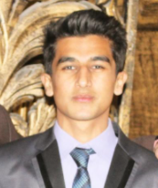
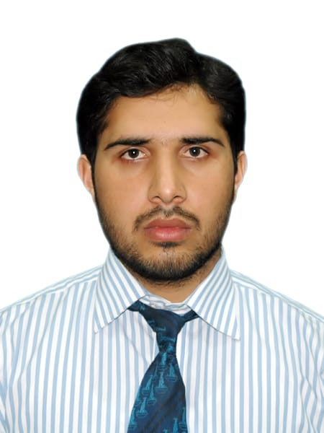
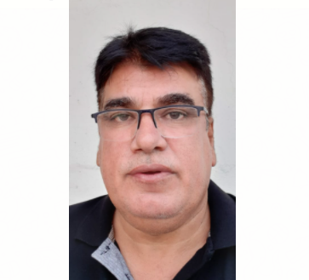
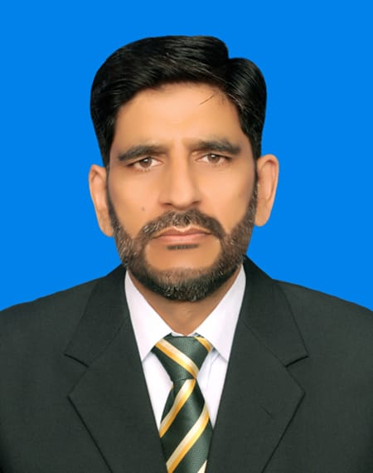
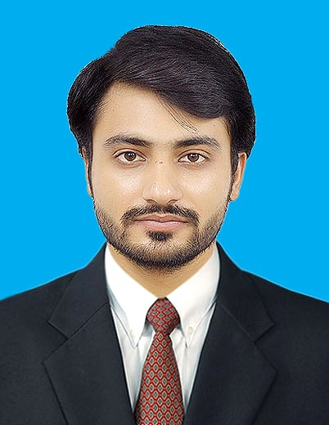
Senior Members of Organization
Muhammad Shafiq khan
Fahad Iqbal Shah
Muhammad Iqbal Shah
CEO
Lt Col Muhammad Asif Siddique(R)
Muhammad Zaheer khan

Slide 8
LIST OF STAFF
Members Name Qualification Designation
Muhammad Iqbal Shah Master Mariner CEO
Fahad Iqbal Shah BSc Civil Engineering Managing Director
Lt Col M Asif Siddique (R) lsc, HR & Material Management IBA Executive Director
Muhammad Zaheer khan BSc Civil Engineering Engineer
Muhammad Shafiq khan Electrical Engineering Engineer
Riasat shah B.Tec Civil Engineering Engineer
Bilal Shah BSc Civil (cont) Engineer

Slide 9
LIST OF STAFF
Members Name Qualification Designation
Muhammad Ali MSc Mechanical Engineer
Abidullah Khan MSc Geology Geologist
Muhammad Asaad BSc Horticulture Horticulturist
Daniyal Khan DAE Civil Site Supervisor
Imtiaz Ali SM (JCO) Site Supervisor
Asif Shah BBA Accountant
Umair Afridi DAE Civil Engineer Site Supervisor
Maratab Ali DAE Civil Engineer Supervisor
Tabassum Hussain DAE Electrical Engineer Site Supervisor etc.

Slide 10
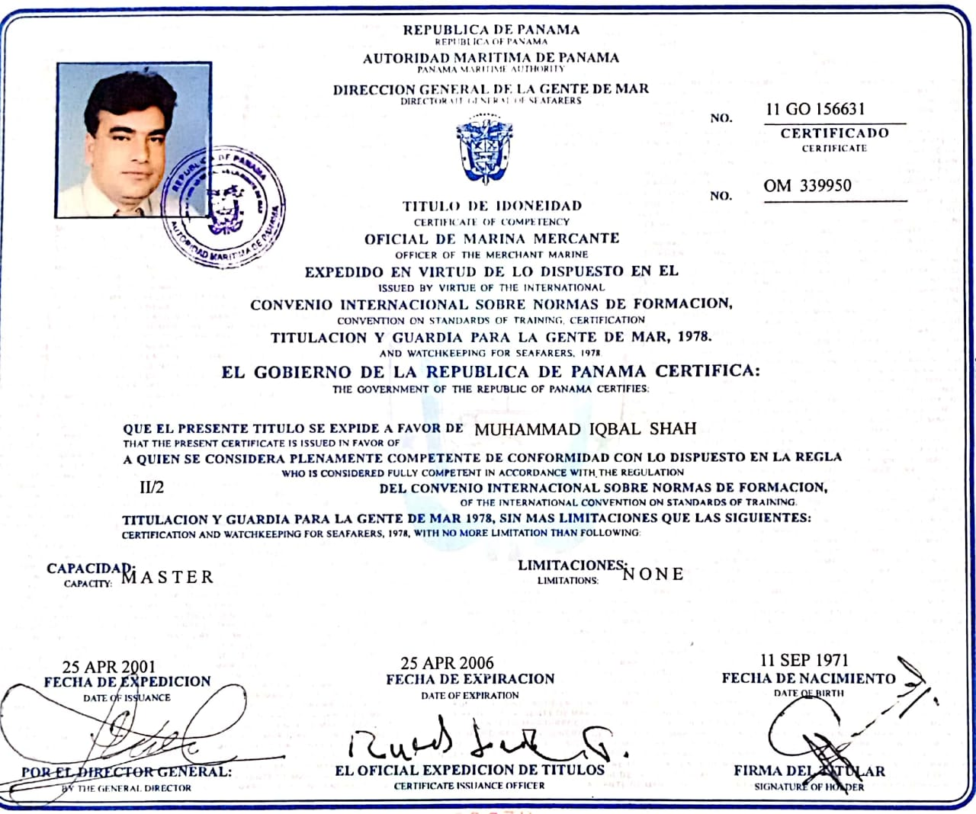
Certificates

Slide 11
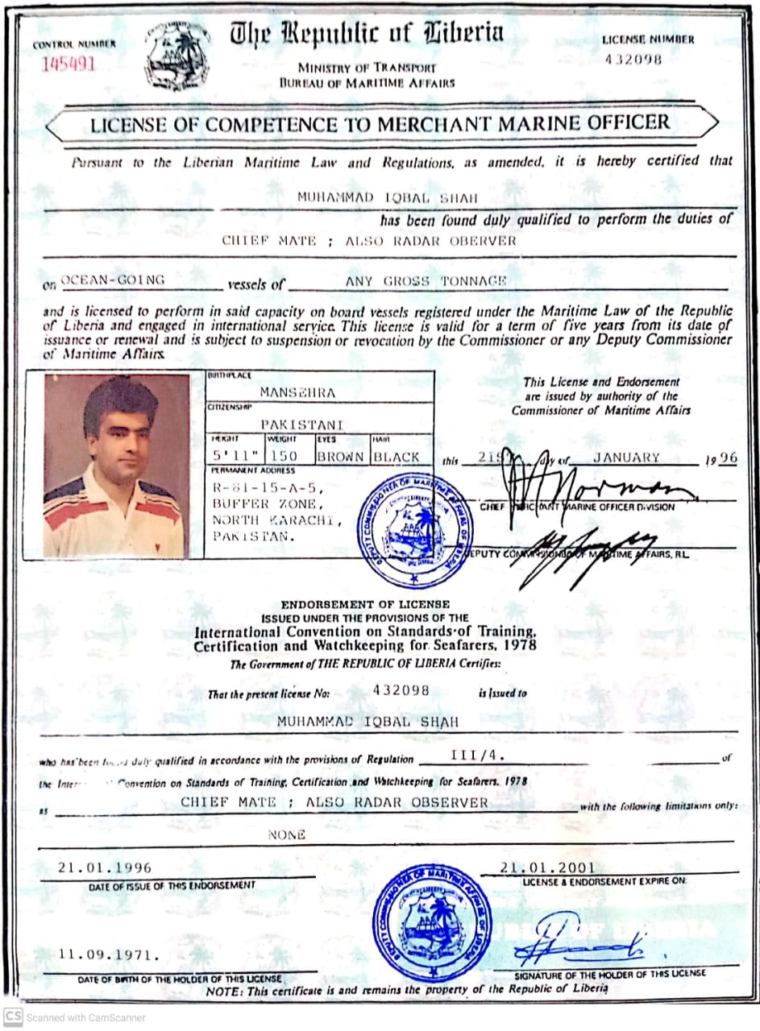
Certificates

Slide 12
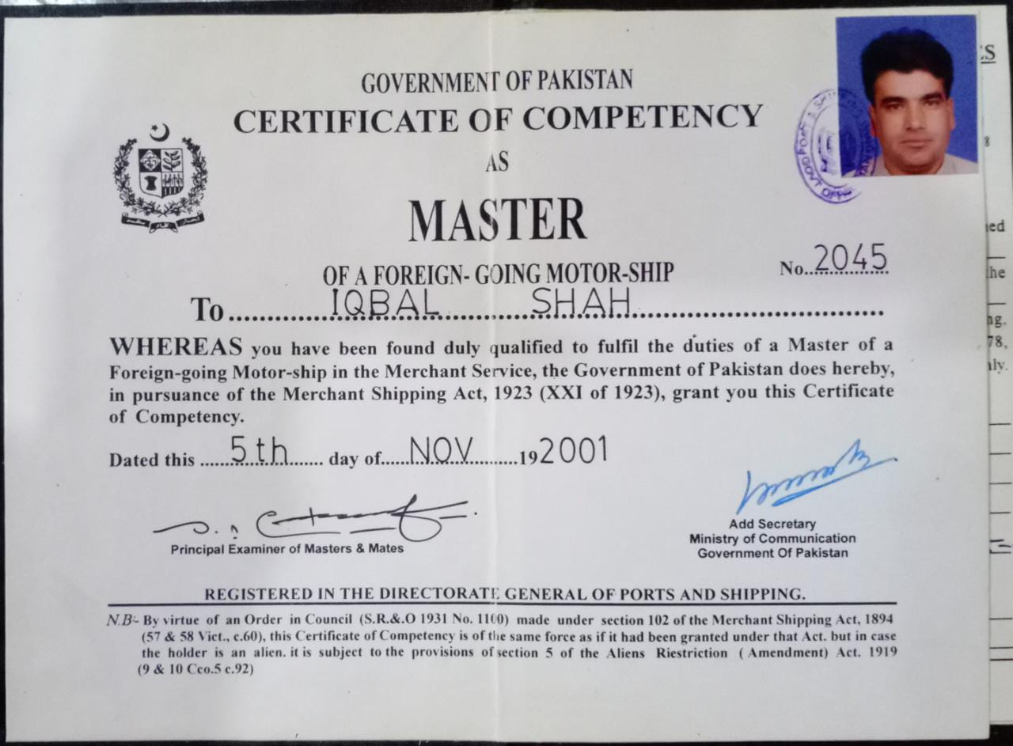
Certificates

Slide 13
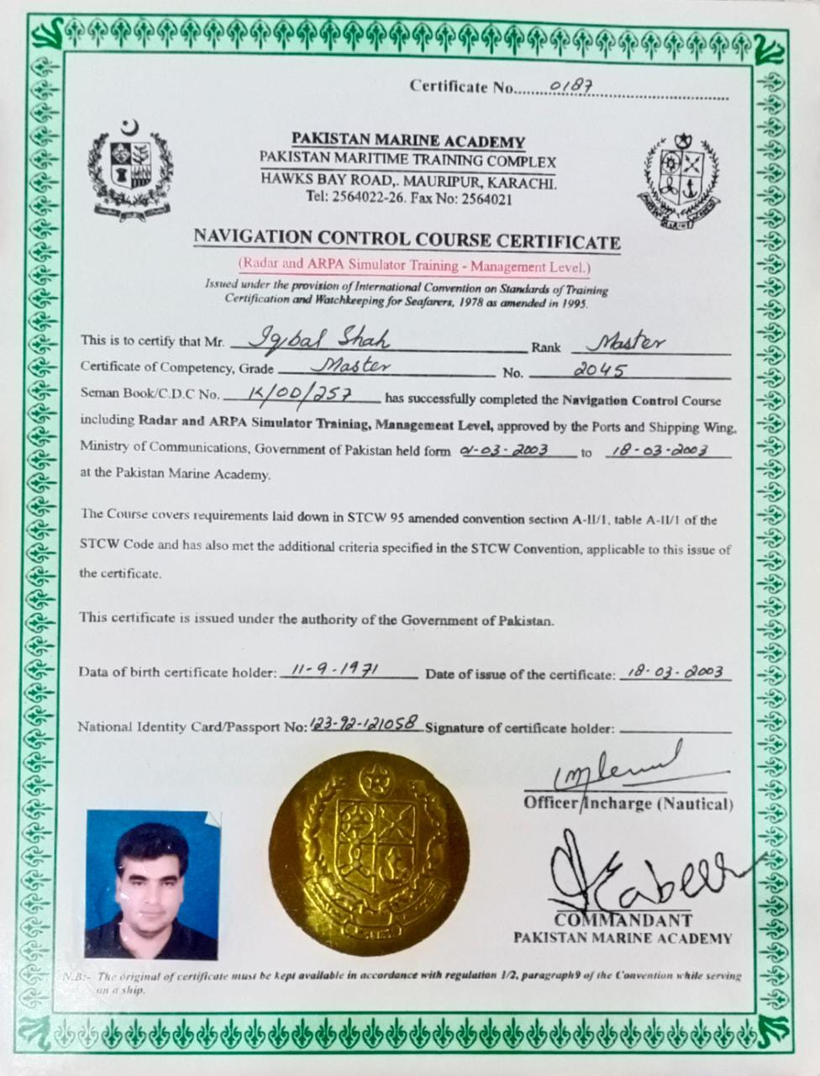
Certificates

Slide 14
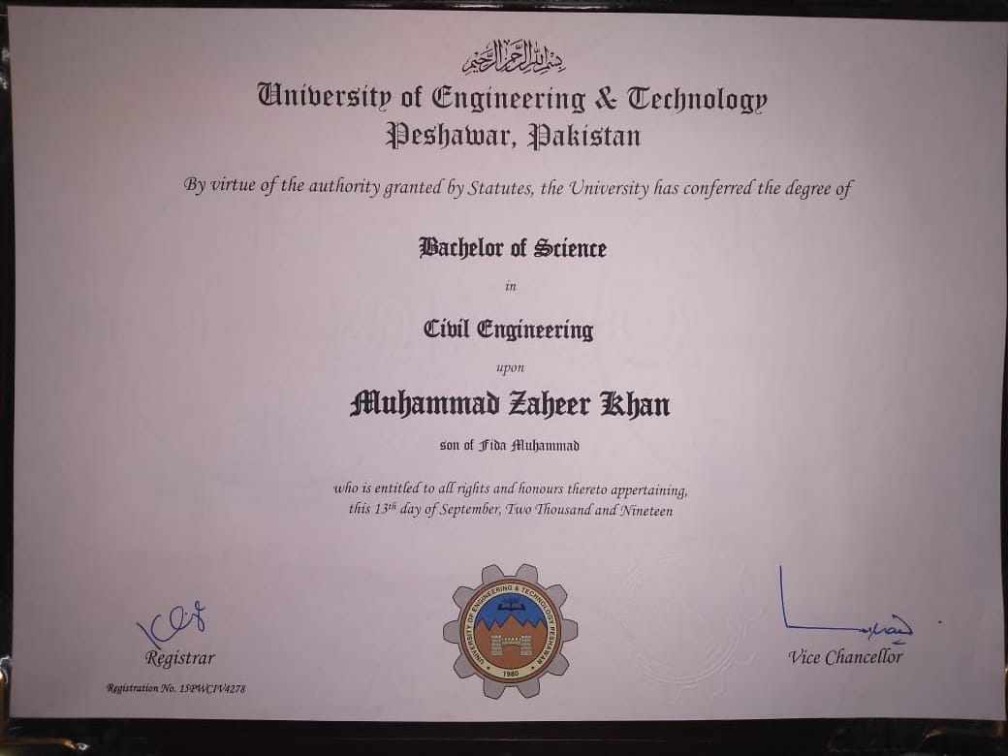
Civil engineer certificate

Slide 15
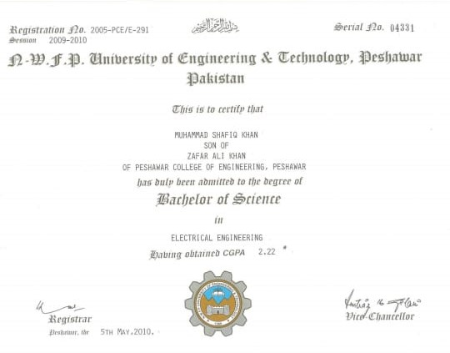
Electrical engineer certificate

Slide 16
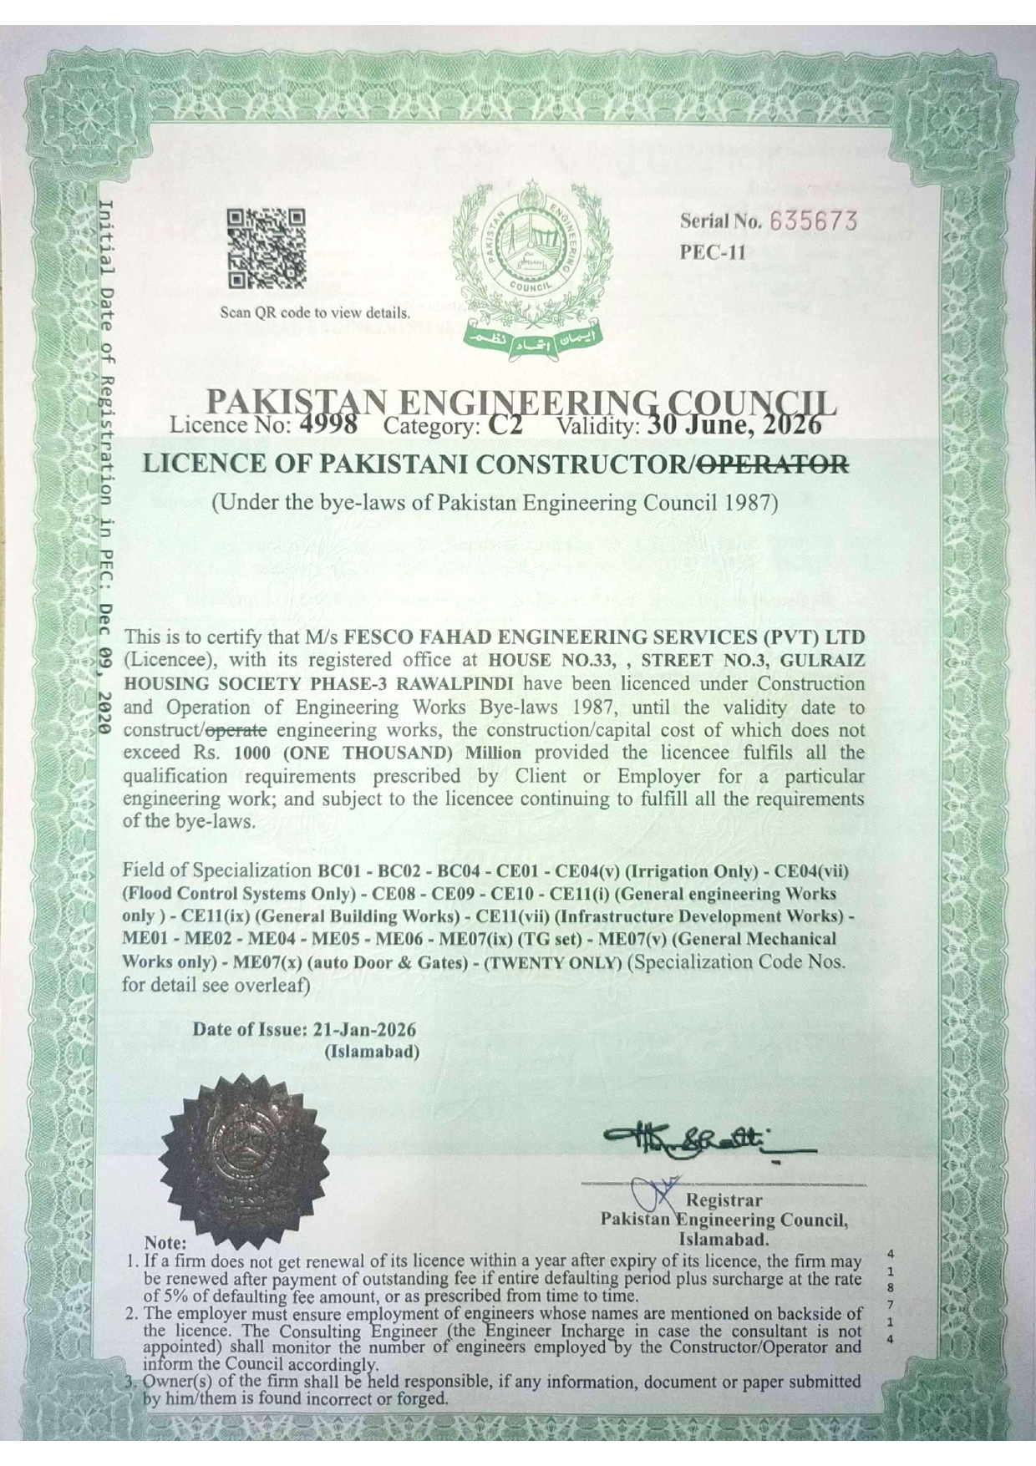
ENLISTMENT
Certificate of “Pakistan engineering council” category c2

Slide 17
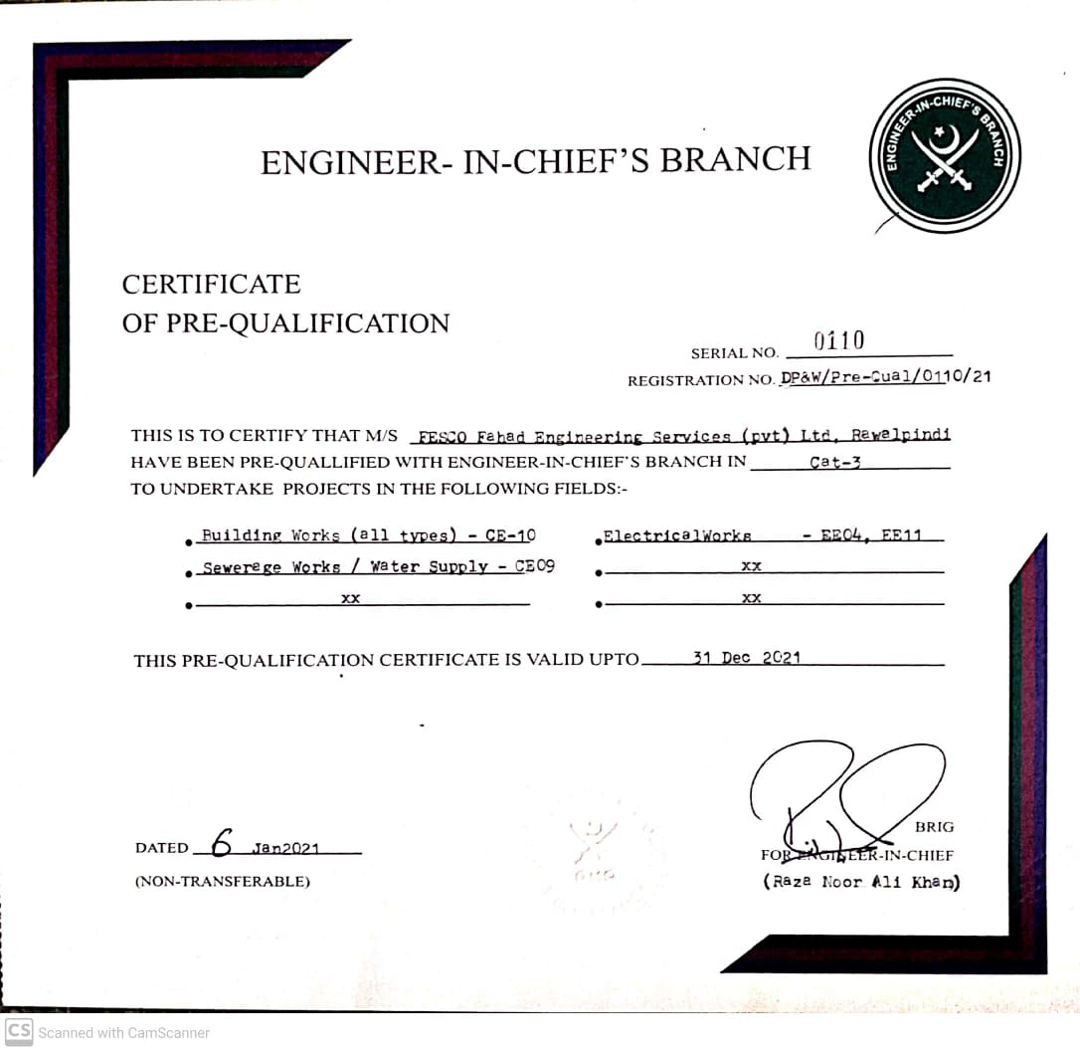
ENLISTMENT
Certificate of “engineer-in-chief’s branch”

Slide 18
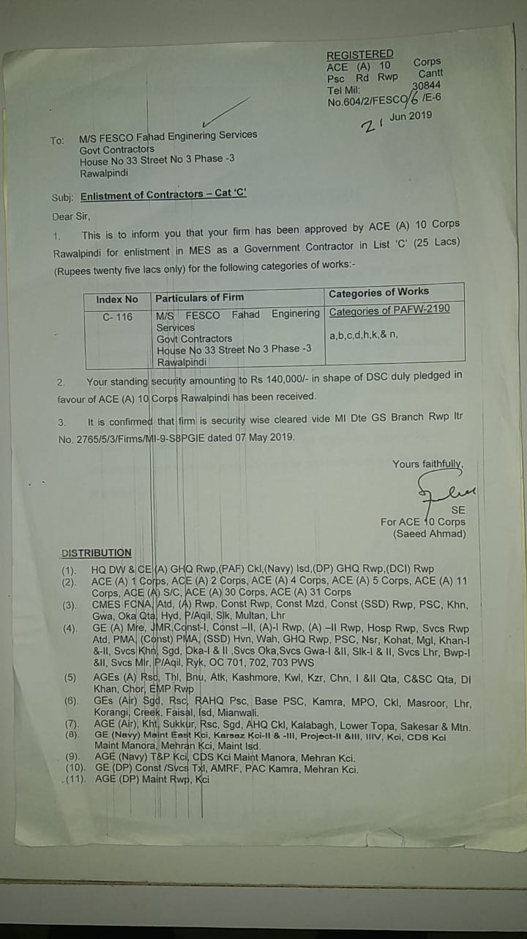
ENLISTMENT
Certificate of “military engineering services”
Category “c”

Slide 19
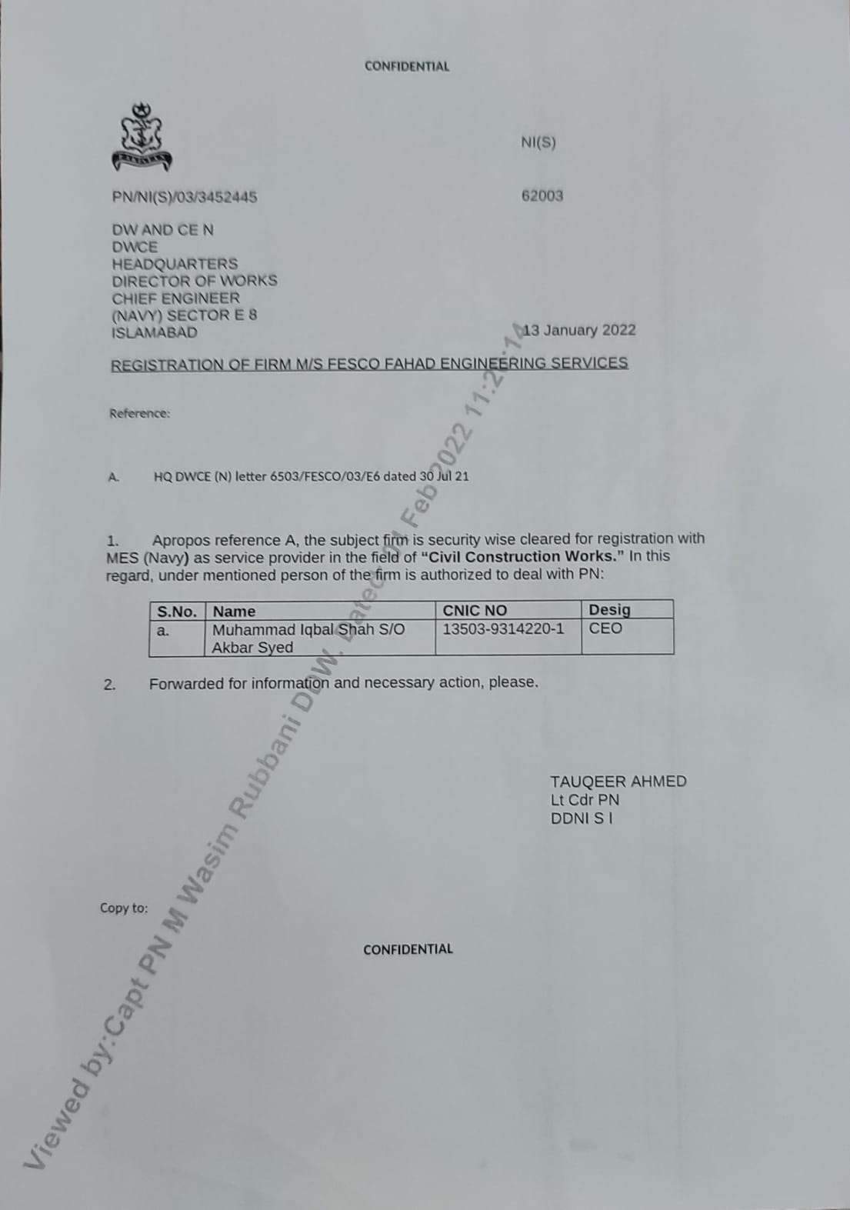
ENLISTMENT
Enlistment in ‘pak navy’

Slide 20
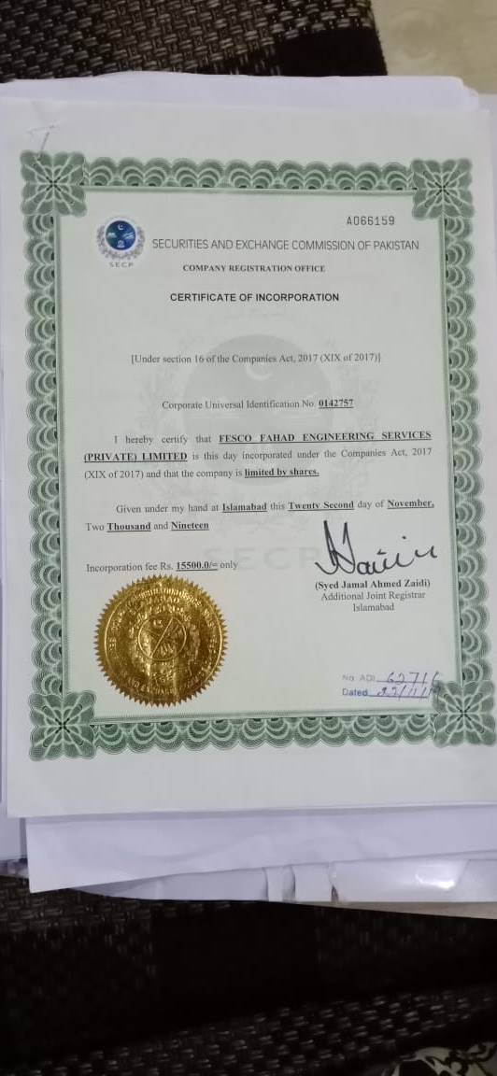
ENLISTMENT
Certificate of “Securities and Exchange Commission of Pakistan (secp)”

Slide 21
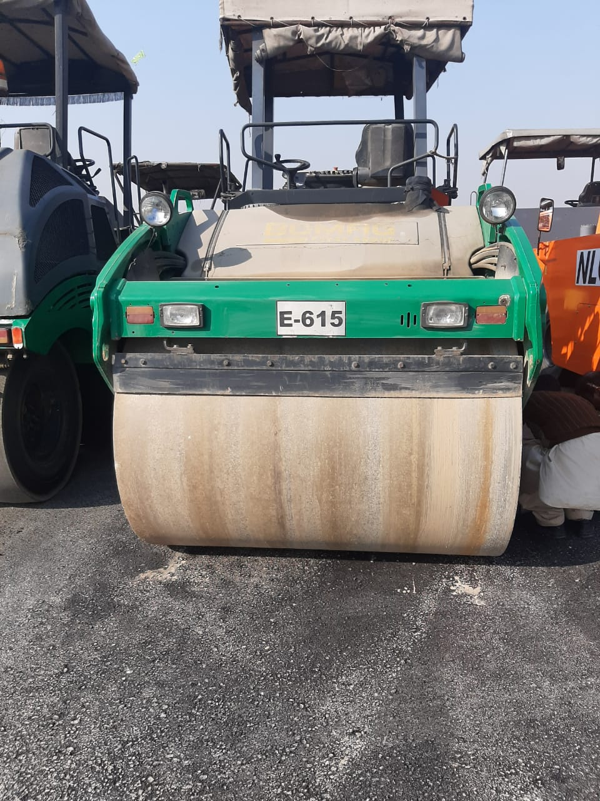
LIST OF MACHINERY
S/No | Machinery | Quantity
1 | Road Roller | 01
2 | Electric Generator | 01
3 | Concrete Mixer | 01
4 | Tower Lift | 01
5 | DTH(Down The Hole Hammer)/Nailing Machine | 01
6 | Tractor with blade, Trolly and boozer | 01
7 | Plywood Shuttering | 5000sft
8 | Scaffolding | 50 ton

Slide 22
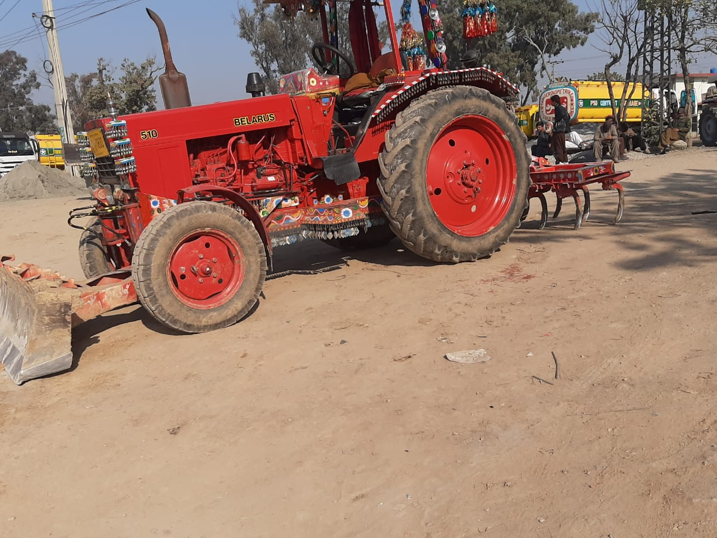
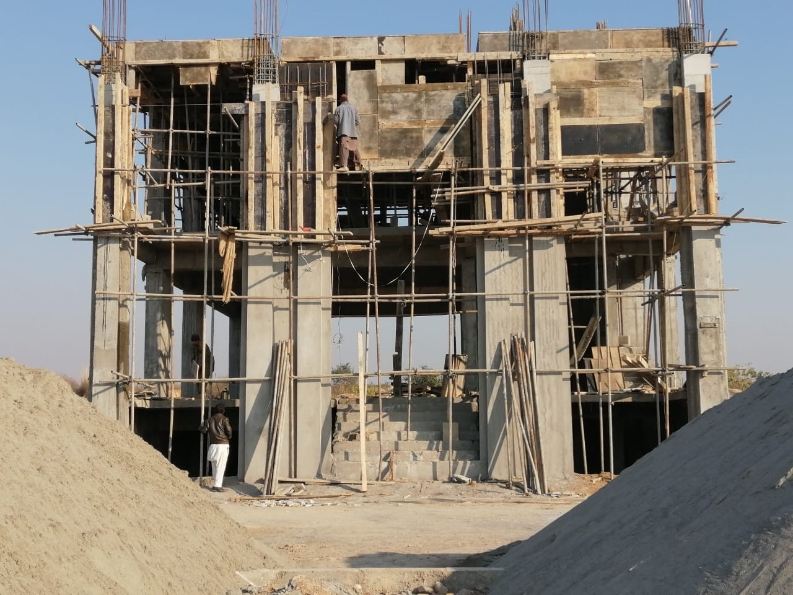
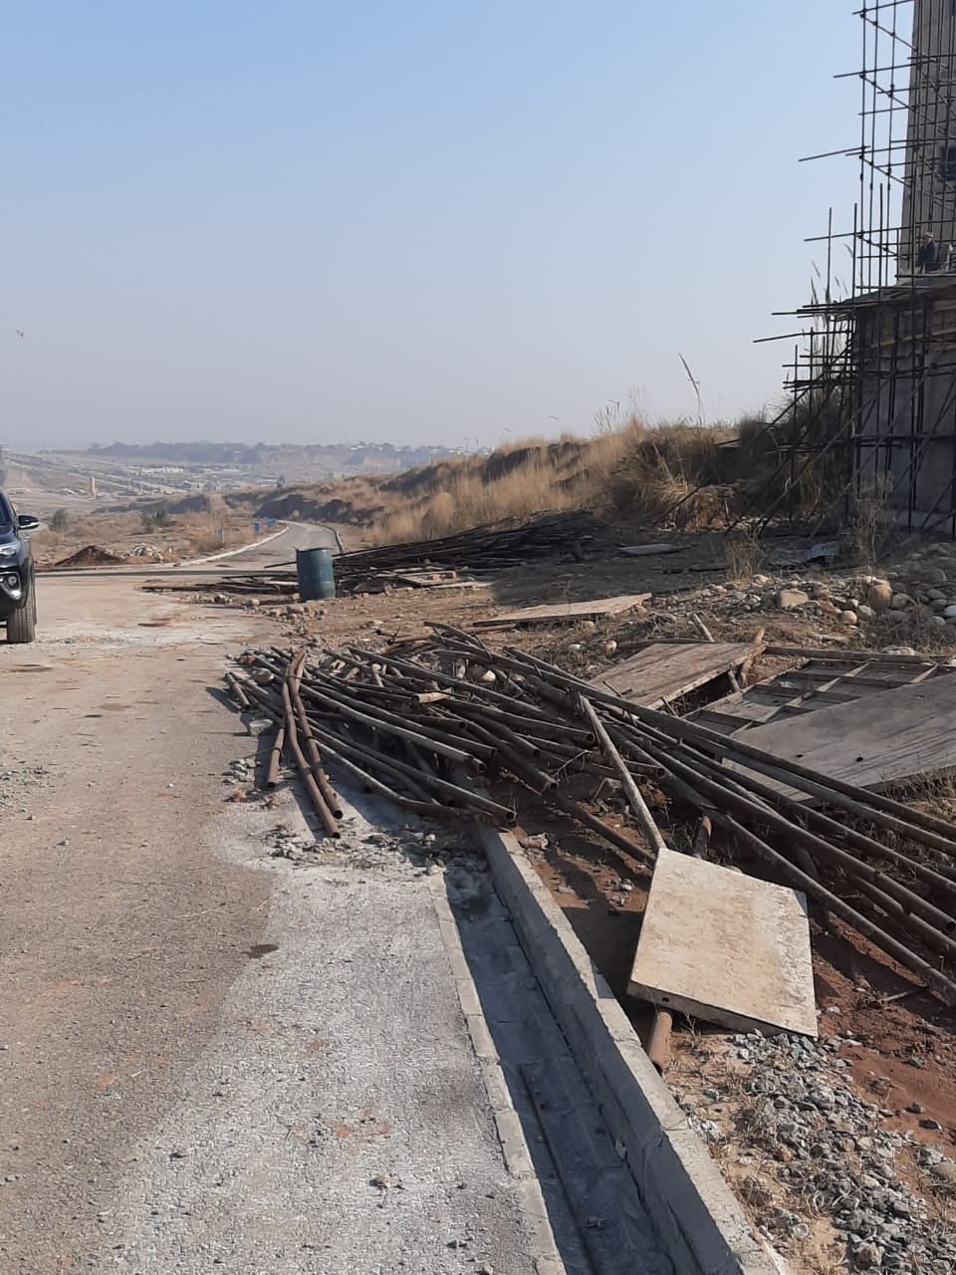
LIST OF MACHINERY
Tractor with Blade, Trolly and Bowzer
Plywood Shuttering
Scaffolding

Slide 23
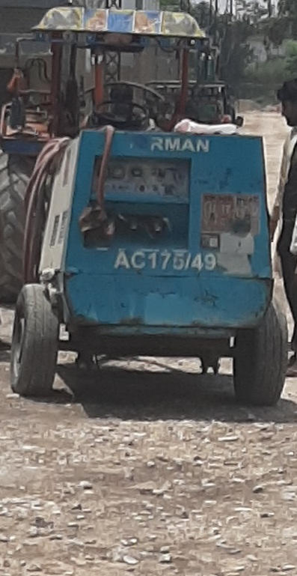
LIST OF MACHINERY
S/No | Machinery | Quantity
9 | Steel Shuttering | 3500sft
10 | Store Container | 01
11 | Mobile Office Container | 02
12 | Concrete Vibrator | 04
13 | Air Compressor | 01
14 | Suzuki Pickup | 02
15 | Welding Plant | 01

Slide 24
COMPLETED PROJECTS
Type of Project / Place | Client | Amount | Year of Completion
Construction of Civil Hospital Tehsil Alai District Batagram | JICA (Japan International Cooperation Agency) | 150 Million | 2013
Construction of Roads, Drains, Culverts and Sewerage in ECHS D/18 Islamabad | ECHS Society | 100 Million | 2014

Slide 25
COMPLETED PROJECTS
Type of Project / Place | Client | Amount | Year of Completion
New Construction and Renovation in Kakul Academy | MES (Military Engineering Service) | 20 Million | 2014
New construction in JLA Shinkiari | MES | 20 Million | 2014
Construction of Anchor Pharma in RCCI Industrial Zone, Rawat | Anchor pharmaceuticals | 80 Million | 2015

Slide 26
COMPLETED PROJECTS
Type of Project / Place | Client | Amount | Year of Completion
Construction of Roads, Drains and Culverts in DHA-5 Islamabad | DHA | 20+20 Million | 2016
Construction of BIM Lab and New PG Block, MCE Risalpur | E-in-C Comd Fund | 50 Million | 2017
CAMP works of GE Army (ll) in QMG Flats, Javed Sultan Shaheed Colony, RAR Camp and New Adm Command | MES | 40 Million | 2018

Slide 27
COMPLETED PROJECTS
Type of Project / Place | Client | Amount | Year of Completion
CAMP works of GE Army (ll) of Hanif Line and Jabbar Flats Dhamial Camp, Aviation Officers Mess and Parade Line. | MES | 75 Million | 2019
CAMP works of GE Army (l) in Mehfooz lines and Rawal Colony | MES | 13 Million | 2019
Repair and Refurbishment of Guddu Barrage | IRSA | 234 Million | 2020
24

Slide 28
COMPLETED PROJECTS
Type of Project / Place | Client | Amount | Year of Completion
CAMP works GE Adm Command, GE Army (ll) and GE Services in Khalil lines, Haneef line and Jabbar Flats | MES | 11 Million | 2020
Installation Of hydraulic Berth Fender at Ormara port | Pak Navy | 100 Million | 2021
Construction of jetty using casing Piles at Marina club Dha Karachi | DHA | 230 Million | 2022
Repair/Refurbishment of Graving Dock at PN Dockyard | Pak Navy | 200 Million | 2023

Slide 29
COMPLETED PROJECTS
Type of Project / Place | Client | Amount | Year of Completion
Construction and Uplifting of Weapon Complex at PN Dockyard | Pak Navy | 120 Million | 2023
Construction of Collage at Hanif SRE | Pak Navy | 130 Million | 2024
Construction of 5 PO blocks at Abbas SRE PNAD Marripur | Pak Navy | 170 Million | 2024
Construction of 50 Tonnes -25ºC Cold Storage at VSD | Pak Navy | 140 Million | 2024
Construction of 737 Gyro workshop At PN Dockyard | Pak Navy | 140 million | 2025

Slide 30
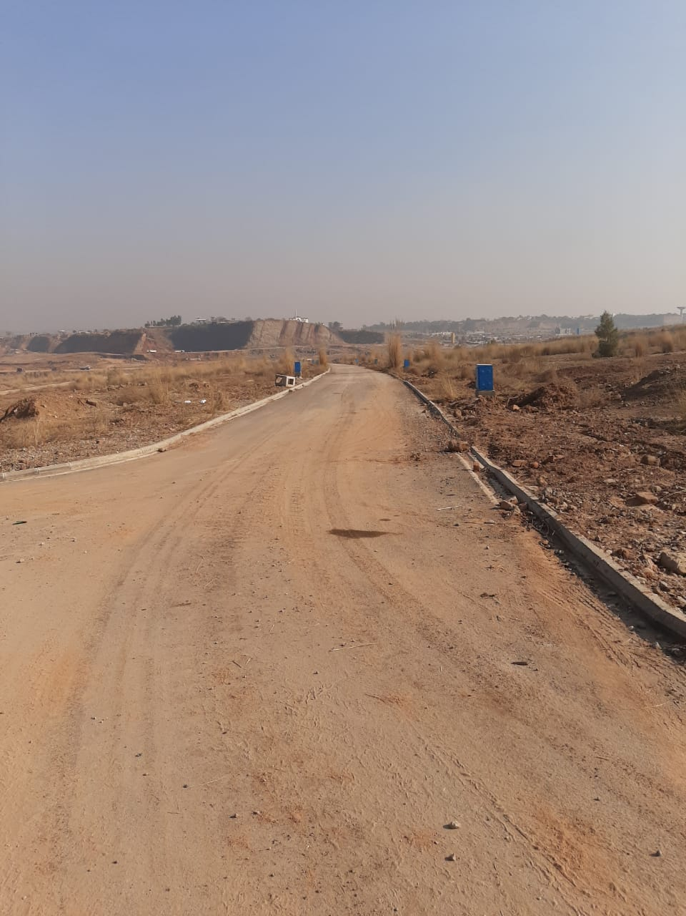
Construction of Roads in DHA-5 Islamabad

Slide 31
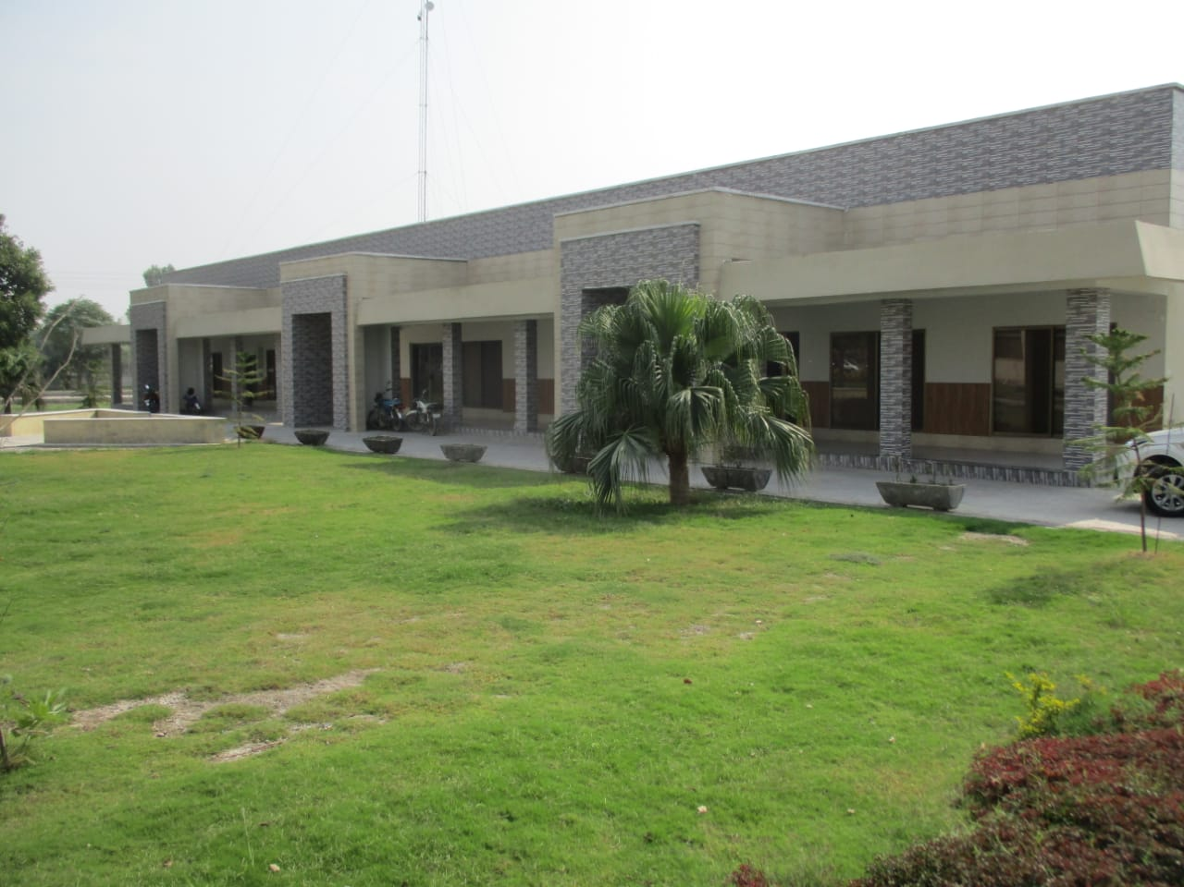
Construction of BIM Lab and New PG Block MCE Risalpur
Slide 18

Slide 32
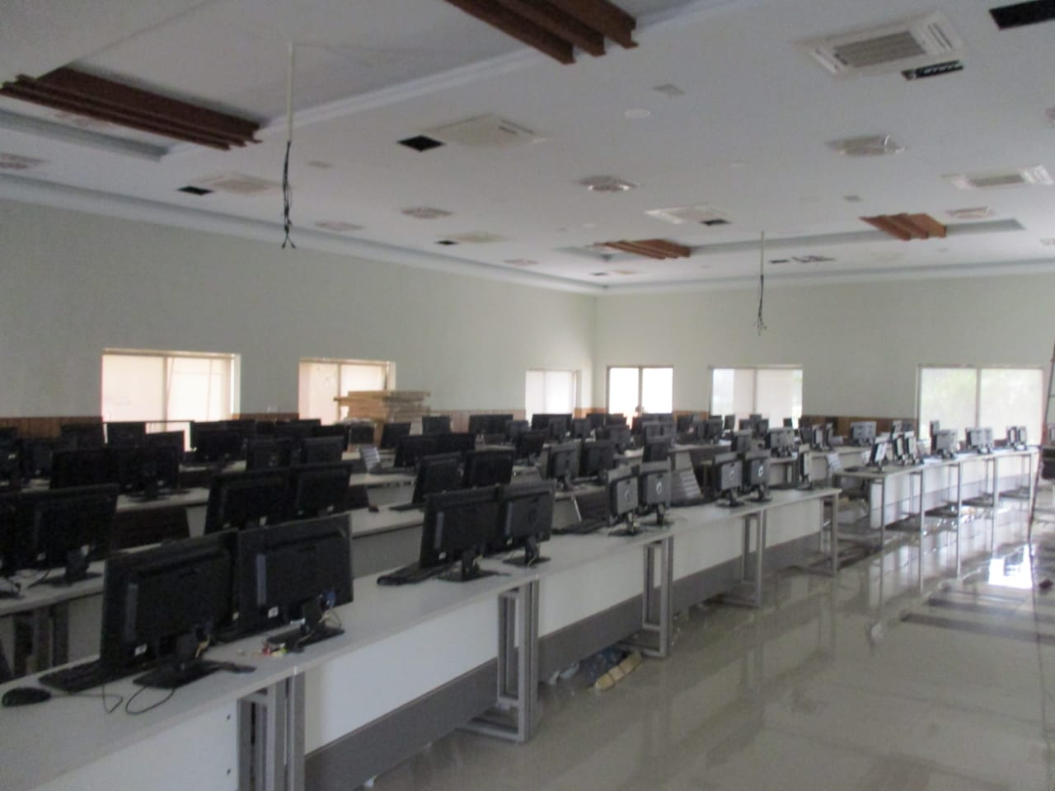
Construction of BIM Lab and New PG Block MCE Risalpur

Slide 33
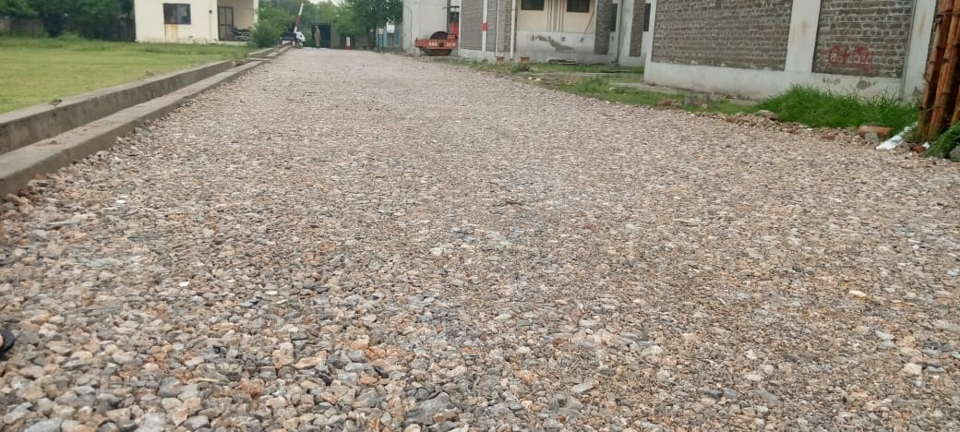
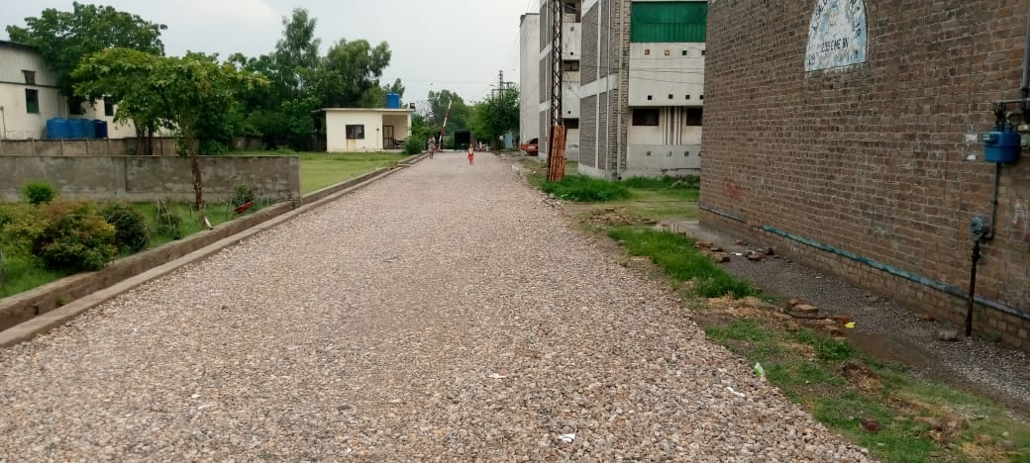
CAMP works of GE Army (ll) of Hanif Line and Jabbar Flats Dhamial Camp, Aviation Officers Mess and Parade Line.

Slide 34
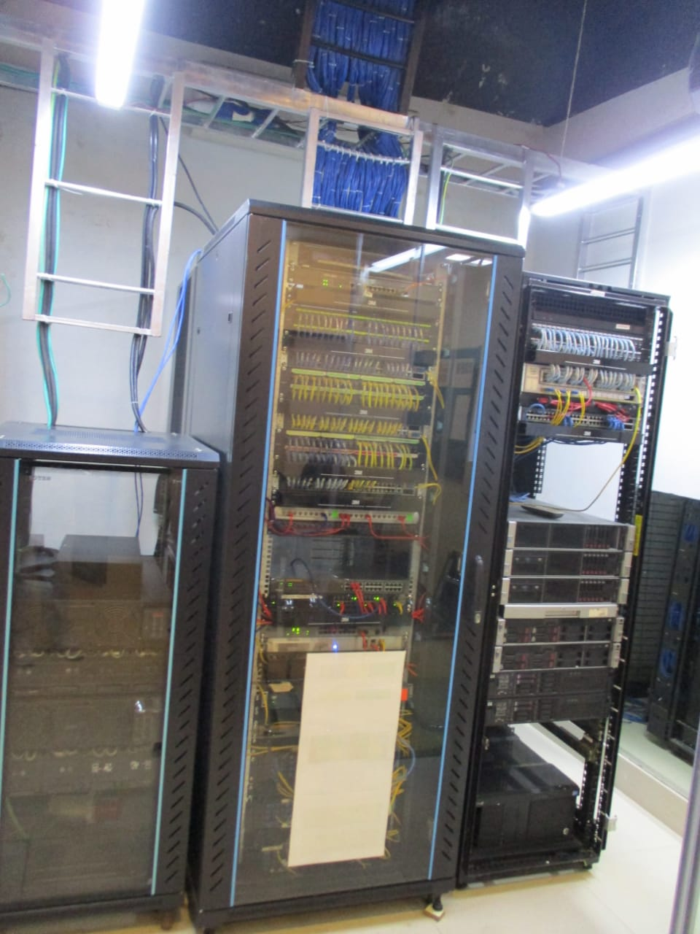
Construction of BIM Lab and New PG Block MCE Risalpur

Slide 35
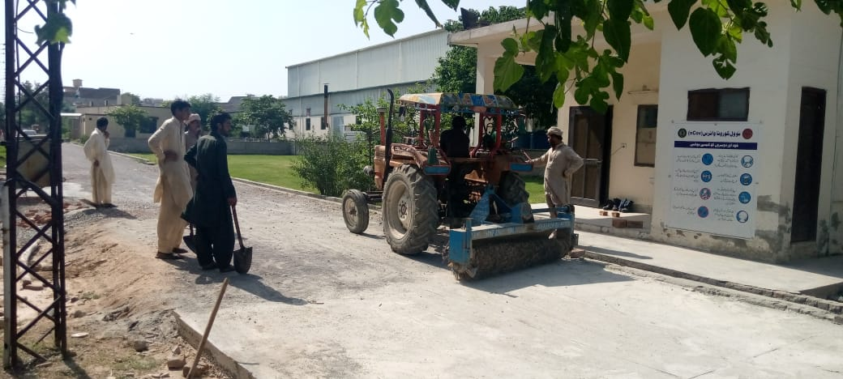
CAMP works of GE Army (ll) of Hanif Line and Jabbar Flats Dhamial Camp, Aviation Officers Mess and Parade Line.

Slide 36
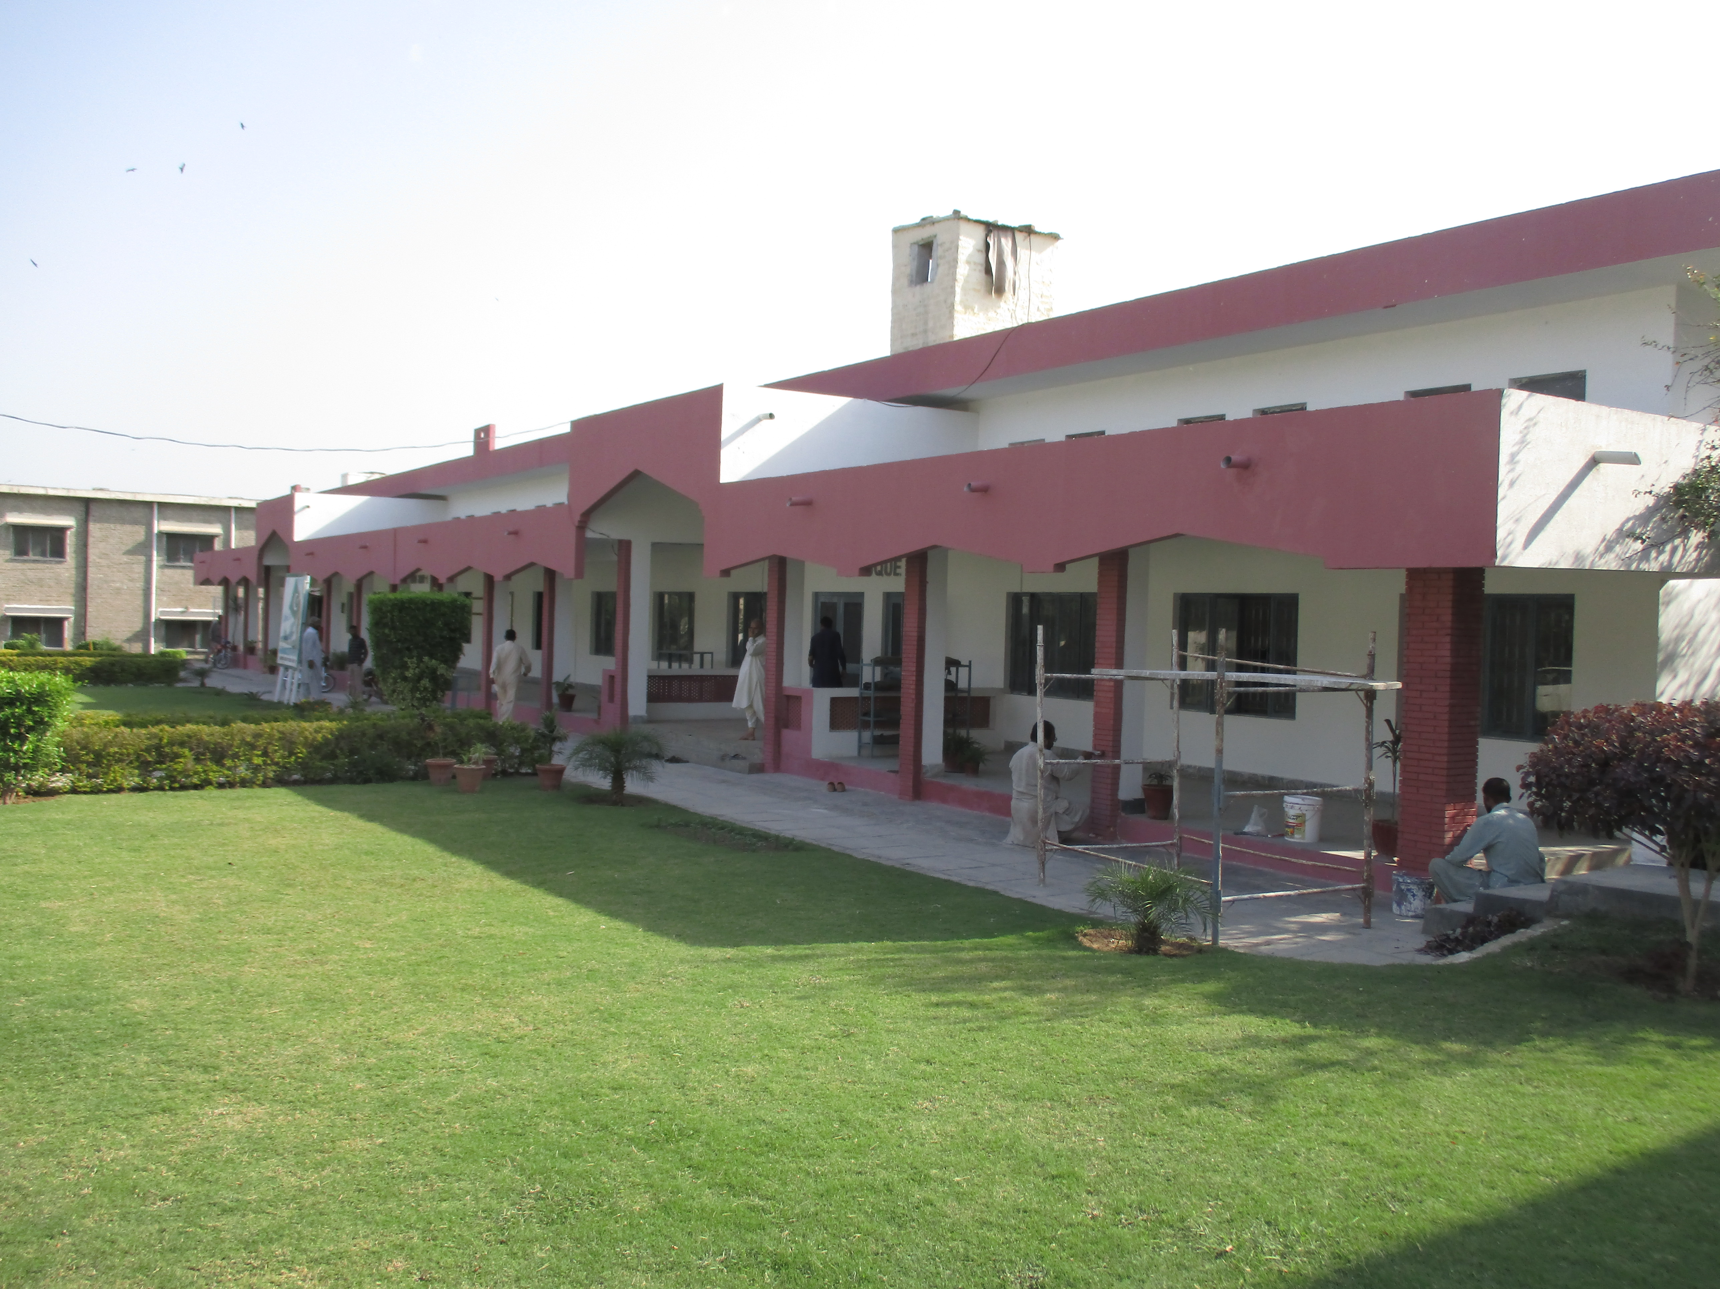

Slide 37
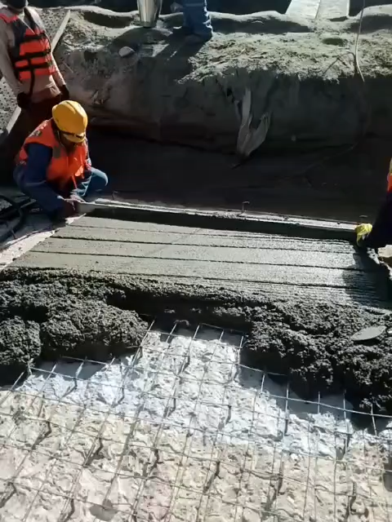
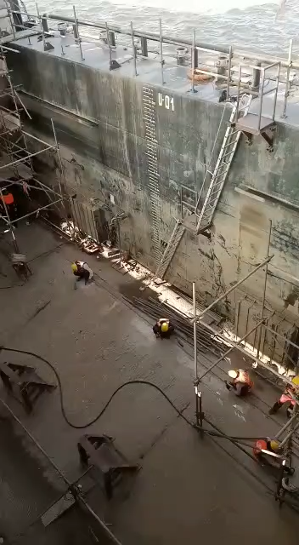
Guddu Barrage

Slide 38
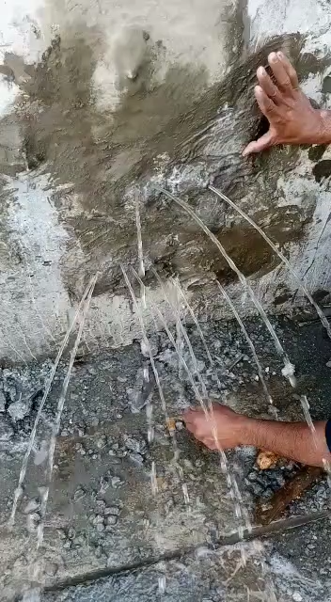
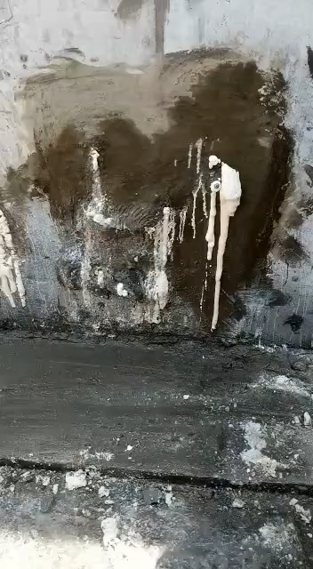
GUDDU BARRAGE

Slide 39
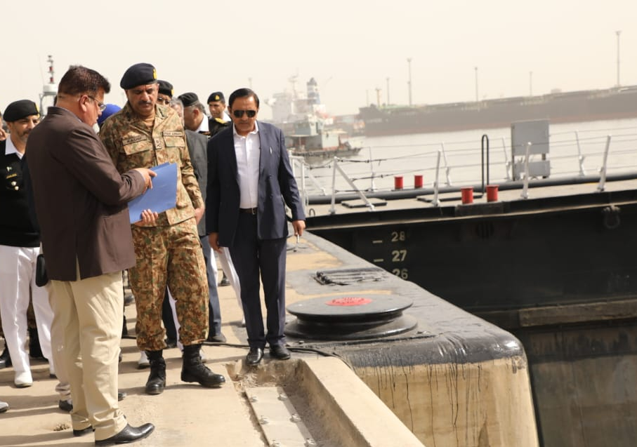
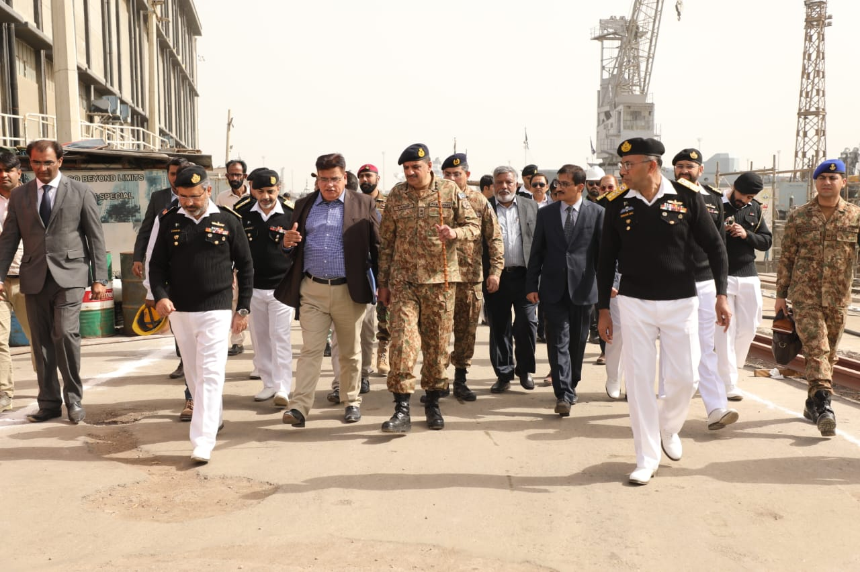
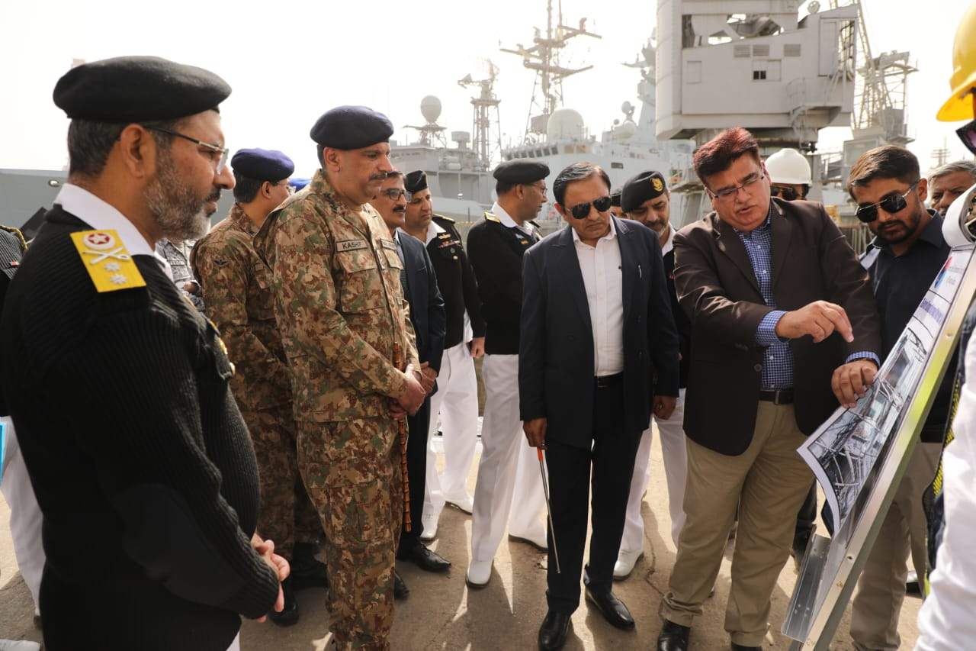
BREIFING TO ENC AT GRAVING DOCK

Slide 40
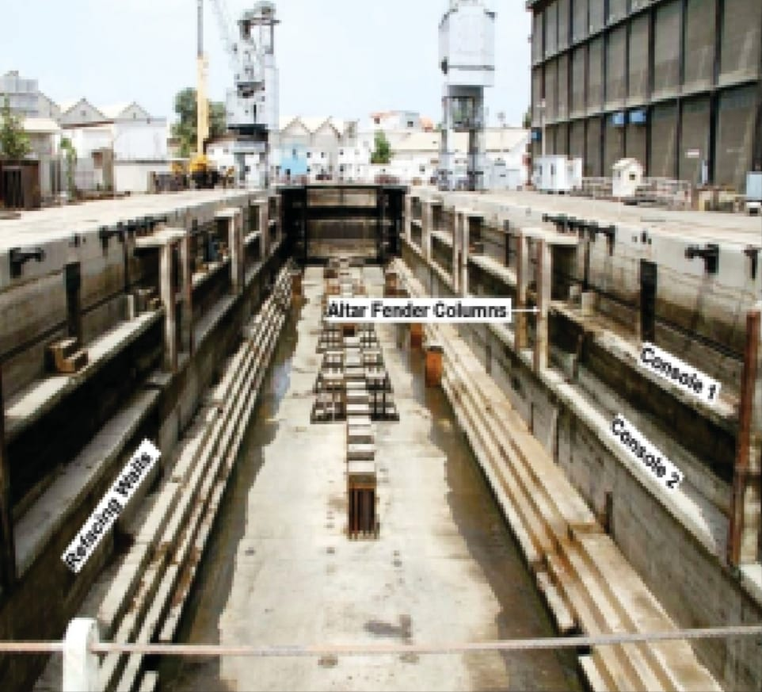
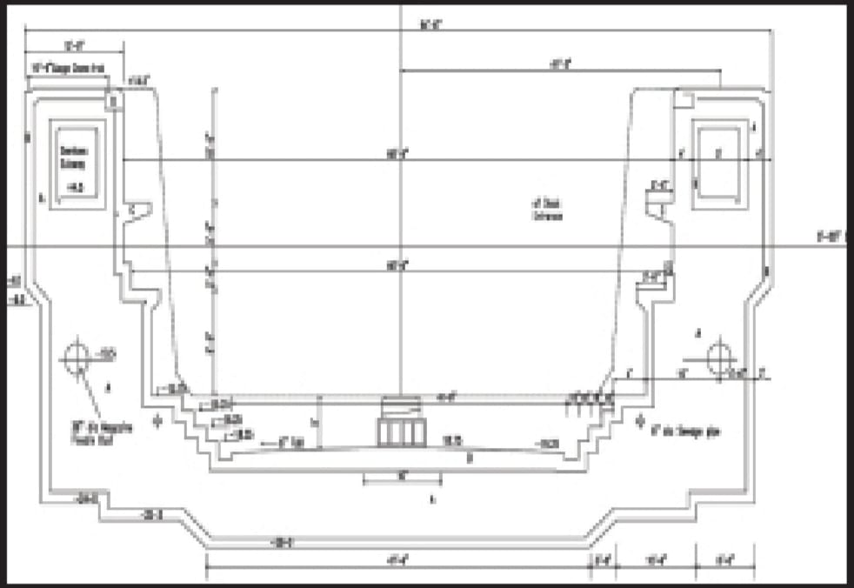
Graving Dock at pn Dockyard

Slide 41
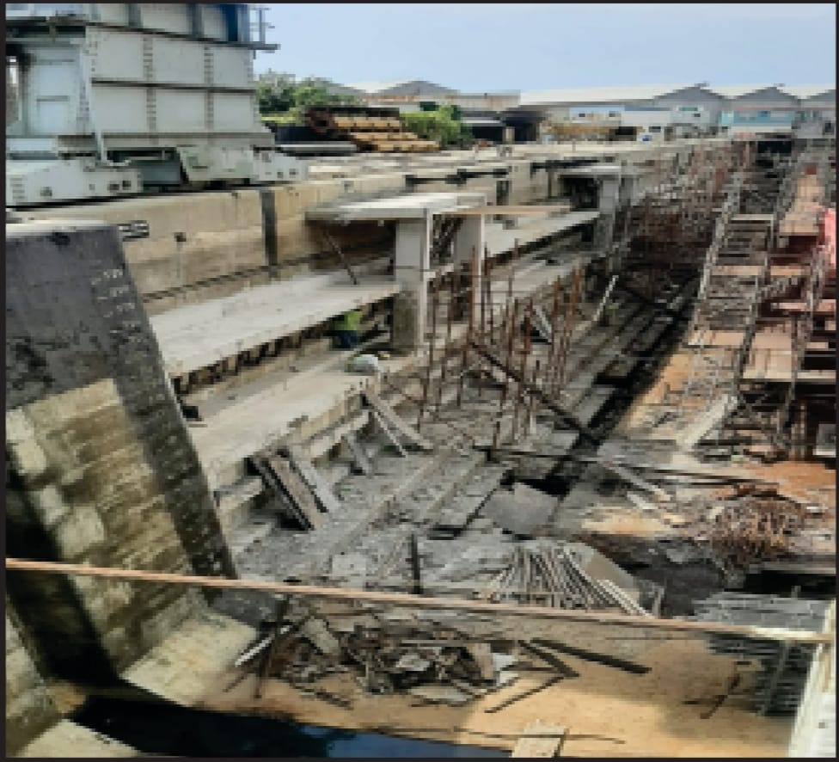
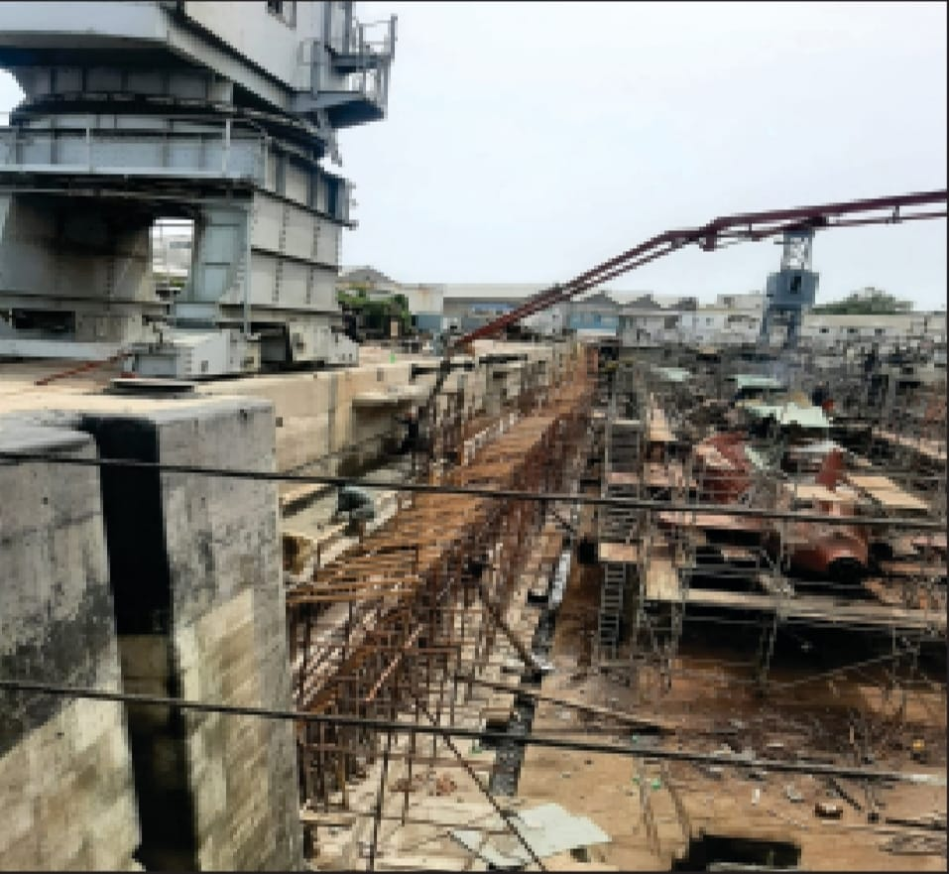
Graving Dock at pn Dockyard

Slide 42
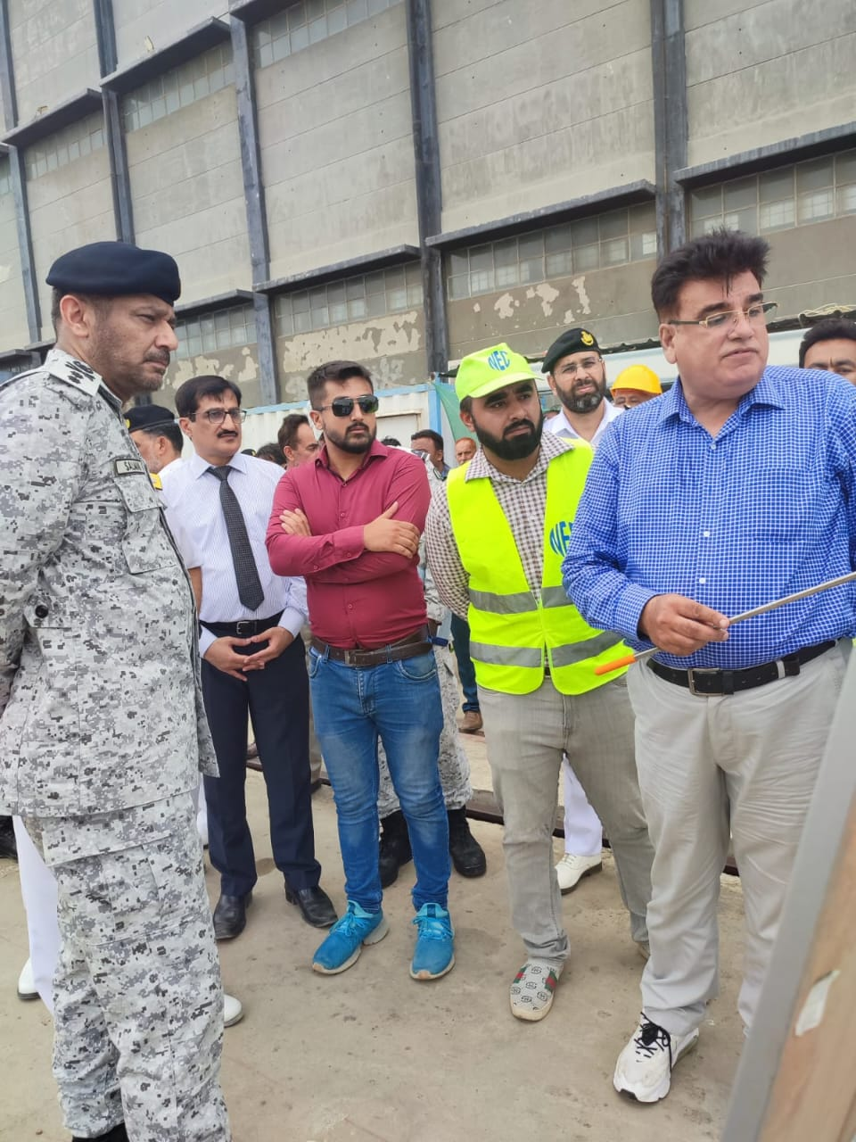
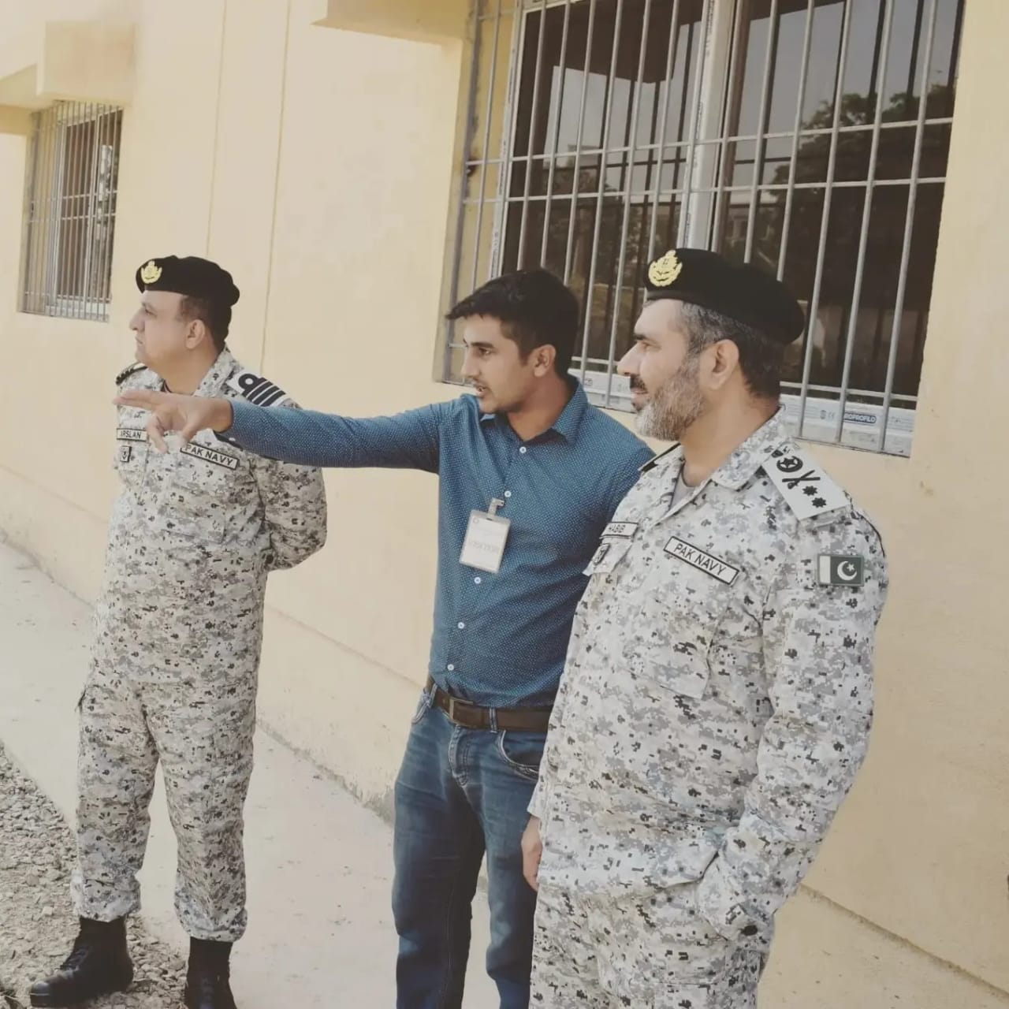
BREIFING AT 737 WORKSHOP & VSD OF DCNS (ADMIN ) & COMLOG

Slide 43
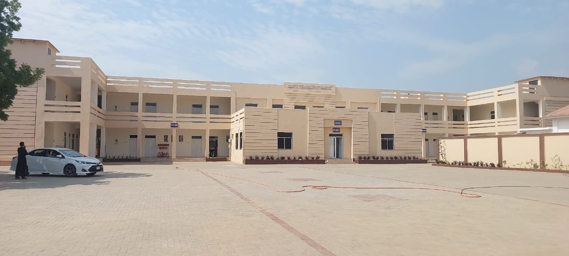
CONSTRUCTION OF COLLEGE AT HANIF SRE

Slide 44
PROJECT IN Progress
Type of Project / Place | Client | Amount | Year of Commence
Construction of Jamia Mosque sector F Dha 2 Islamabad | DHA | 240 Million | 2025
Slope stabilization at Street 16 East & West Side DHA 4 Islamabad | DHA | 90 Million | 2025
Slope stabilization at street 69 & 70 Sector B DHA 3 | DHA | 70 Million | 2025

Slide 45
PROJECT IN Progress
Type of Project / Place | Client | Amount | Year of Commence
Slope Stabilization Of Main Musharaf Road using Corrugated pipes and Nailing Systems DHA 4 | DHA | 140 Million | 2025
Strengthening of Retaining Wall in sawn River DHA 4 | DHA | 160 Million | 2025
Constructions of 5 PO Blocks at Abbas SRE PNAD Mauripur | PAK Navy | 170 Million | 2024

Slide 46
PROJECT IN Progress
Type of Project / Place | Client | Amount | Year of Commence
Supply & Installation of Gantry Crane Of 15 tonnes HE Surface at PN Dockyard | Pak Navy | 150 Million | 2025
Construction of Peri Scope Clean room at PN Dockyard | Pak Navy | 30 Million | 2025

Slide 47
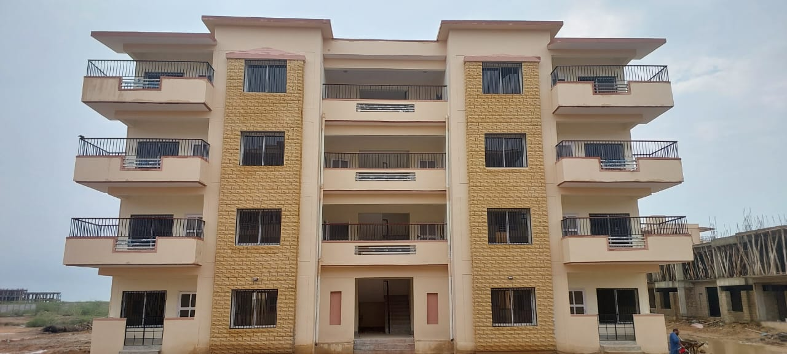
CONSTRUCTION OF PO BLOCKS

Slide 48
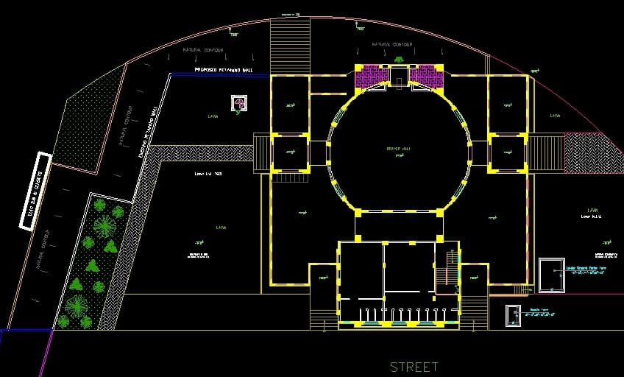
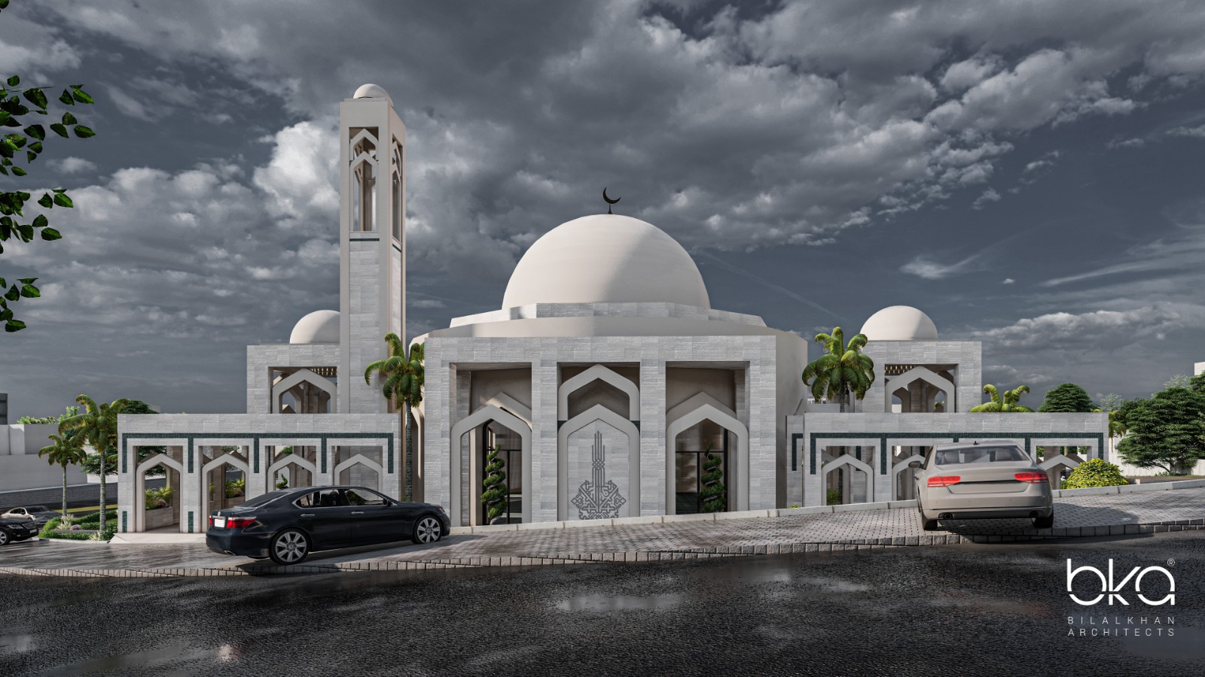
CONSTRUCTION OF JAMIA MOSQUE DHA II

Slide 49
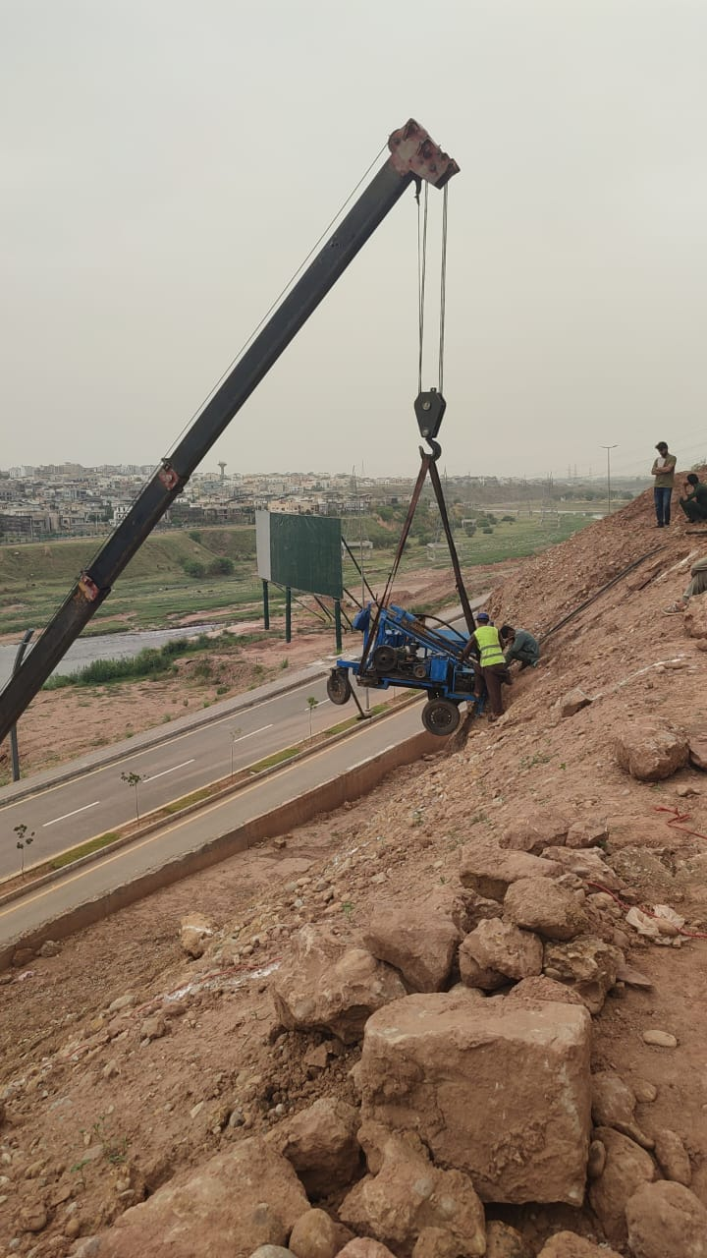
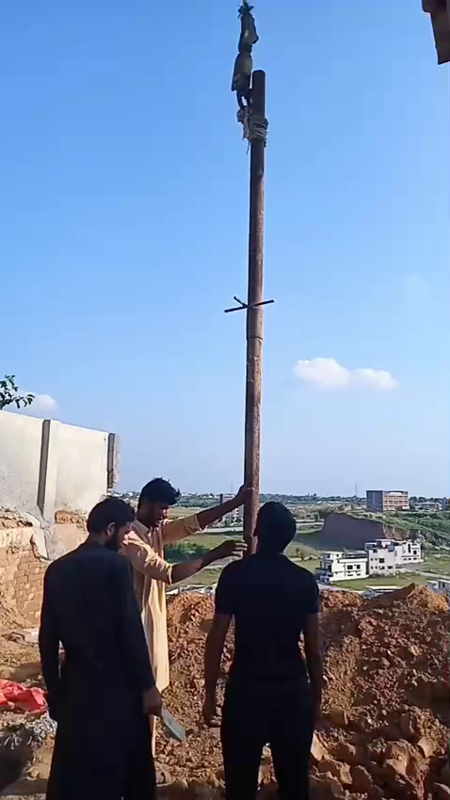
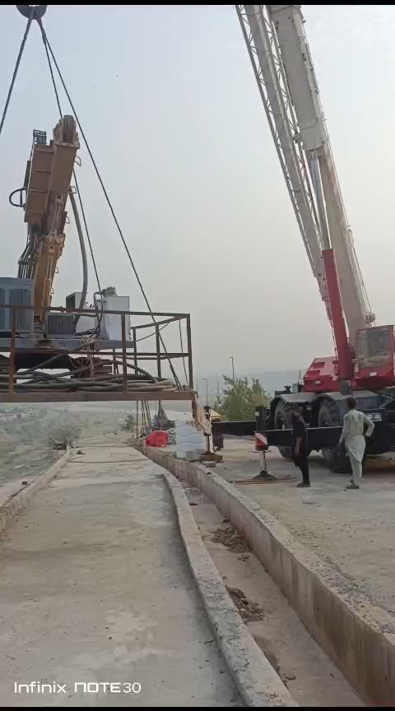
SLOPE STABALIZATION DHA IV

Slide 50

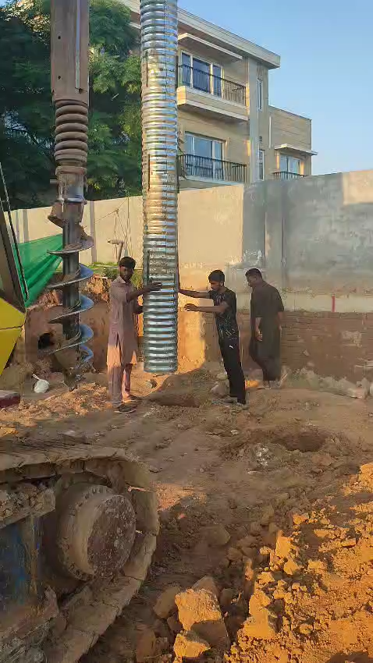

SLOPE STABALIZATION DHA III CORRUGATED PIPE

Slide 51
Bank guarantee
FESCO FAHAD ENGINEERING SERVICES Pvt Ltd financially sound to run any kind of Project.
We have Bank Guarantee from Habib Metropolitan Bank.
We have Bank Guarantee from JS Bank.

Slide 52


Guarantee letter from Habib metro bank
FESCO FAHAD ENGINEERING SERVICES Pvt Ltd financially sound to any kind of Project. We have Bank Guarantee from Habib Metropolitan Bank
22

Slide 53


guarantee letter Js bank
23

Slide 54

Undertaking from CEO
FESCO FAHAD ENGINEERING SERVICES Pvt Ltd financially sound to any kind of Project. We have Bank Guarantee from Habib Metropolitan Bank
24

Slide 55

AWARDs AND Achievements
Lt Gen Khalid Asghar Engineer-in-Chief awarded shield on 18 Oct 2017 in MCE Risalpur for construction of BIM lab and old PG Block
25

Slide 56

“We believe in quality not in quantity”
26

Slide 57
Thank You
28

