Slide 1
MHA Project List
Missing Resolution / Action Items
Presentation from spreadsheet comparison results
The spreadsheet compares resolution/action IDs in the MHA Project List against the first spreadsheet and identifies items missing from the first spreadsheet.
196
128
84
$957.8M
MHA IDs reviewed
Missing from first spreadsheet
Project rows flagged
Costs tied to included rows
Prepared for review and presentation. Figures are derived from the uploaded workbook and should be reconciled against the underlying project/resolution files.
Source: mha_project_list_missing_from_first_spreadsheet(1).xlsx
1

Slide 2
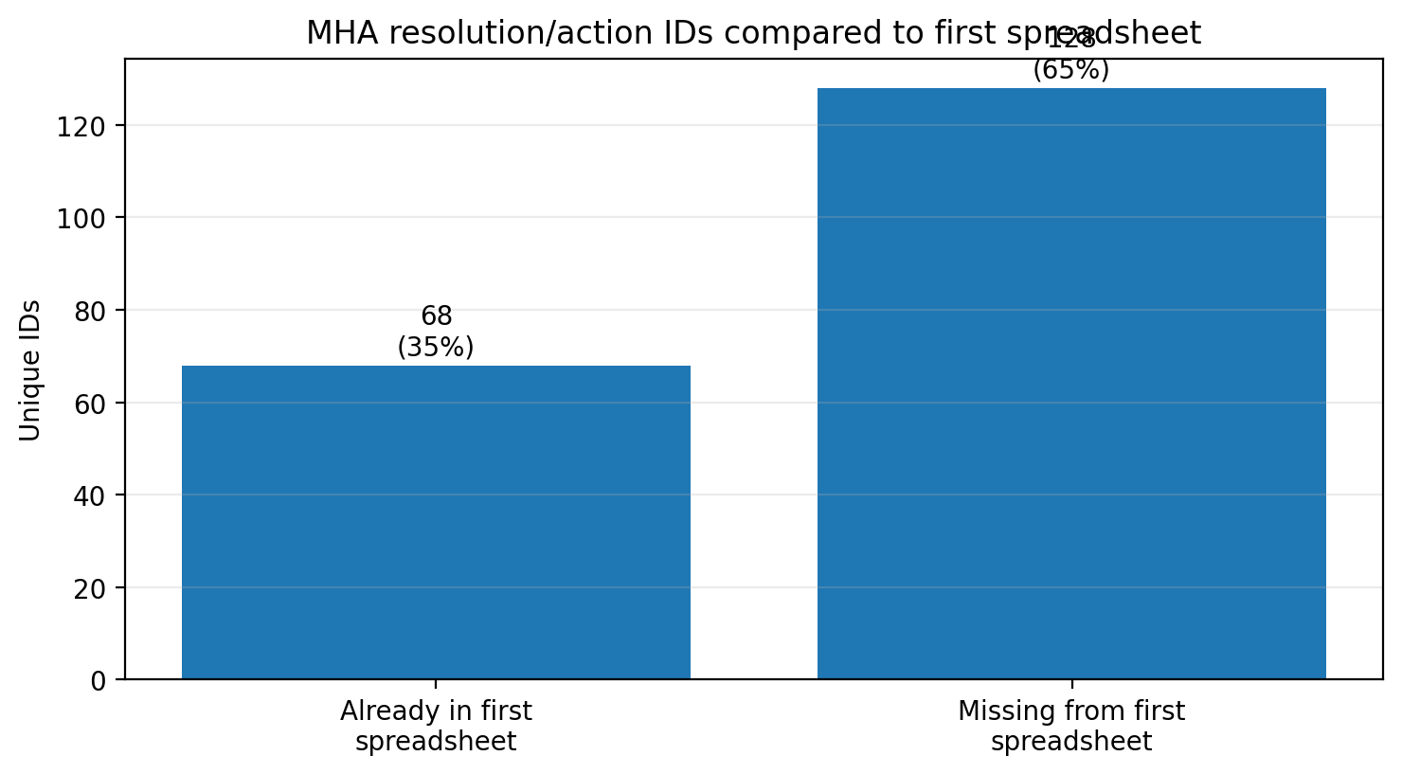
What the spreadsheet says
Comparison of the MHA Project List to the first spreadsheet
KEY FINDINGS
196 unique resolution/action IDs were extracted from the MHA Project List.
68 were already found in the first spreadsheet.
128 were not found in the first spreadsheet, about 65% of the MHA IDs reviewed.
84 MHA project rows were flagged as having at least one missing ID.
The comparison points to a substantial documentation gap, not a final audit conclusion.
Source: mha_project_list_missing_from_first_spreadsheet(1).xlsx
2

Slide 3
Size of the gap
Costs associated with project rows flagged as missing from the first spreadsheet
86
66
$957.8M
Project rows in Missing Project Rows sheet
Rows with costs included in grand total
Total cost used for included rows
Interpretation
The total is not a finding of improper spending; it is the sum of project costs where the missing project row was marked as included in the grand total.
Rows without reliable cost information were not forced into the total.
The numbers should be reconciled against the underlying resolutions, minutes, contracts, amendments, and budget actions.
Source: mha_project_list_missing_from_first_spreadsheet(1).xlsx
3

Slide 4
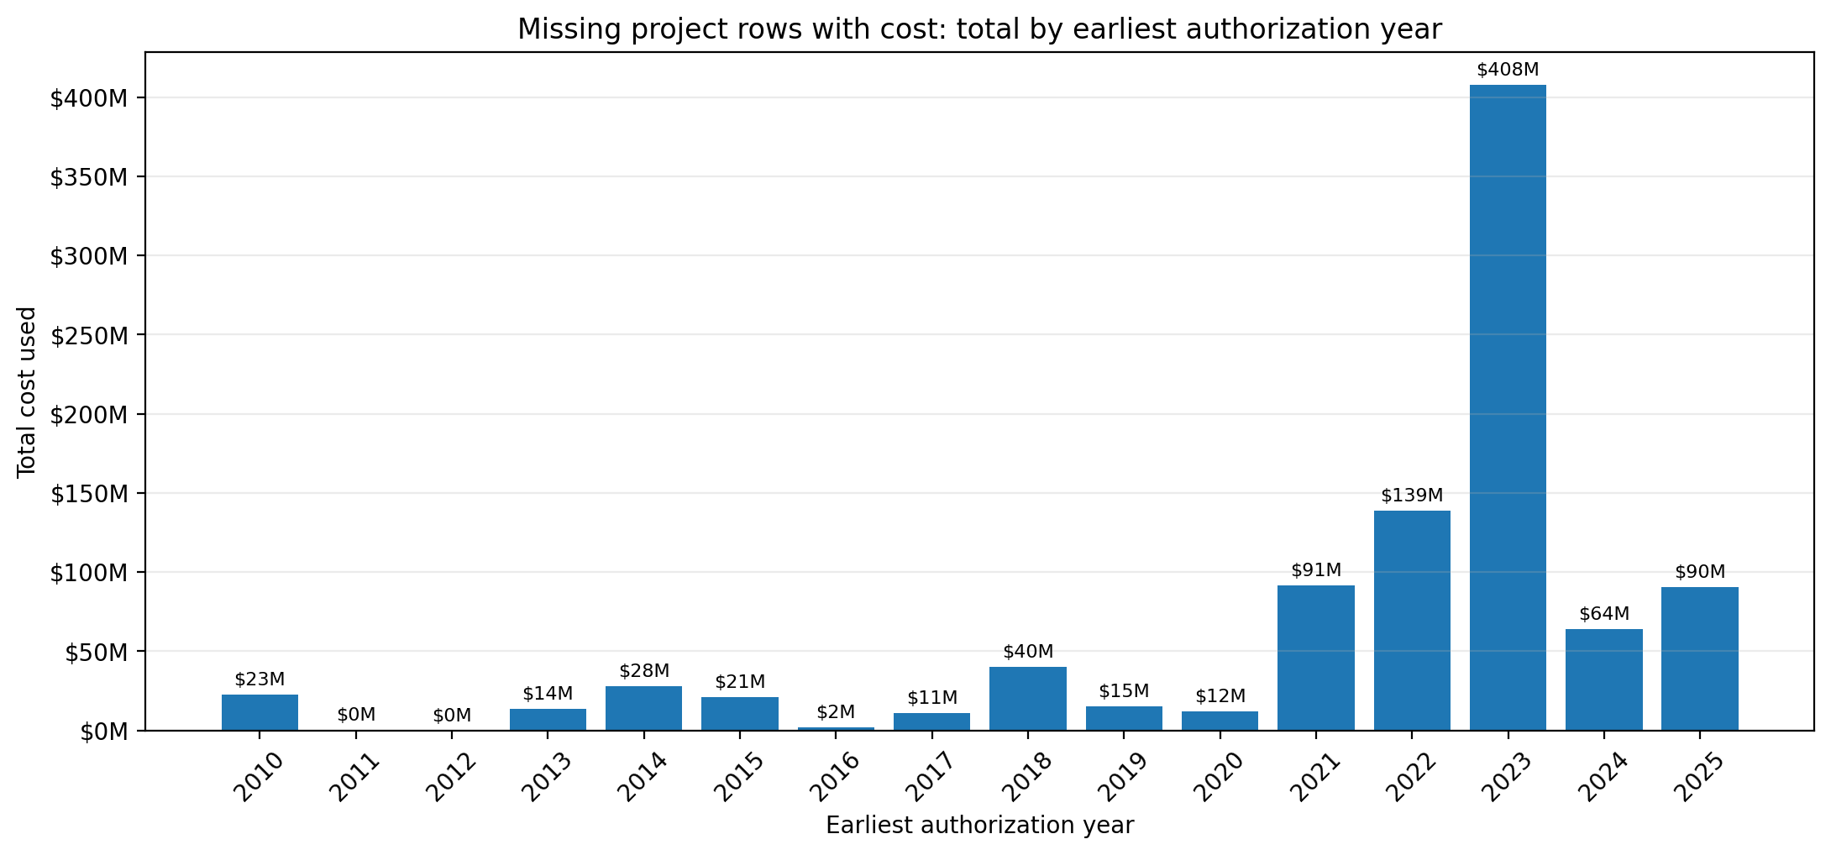
When the missing-cost project rows appear
Total cost used by earliest authorization year
Source: mha_project_list_missing_from_first_spreadsheet(1).xlsx
4

Slide 5
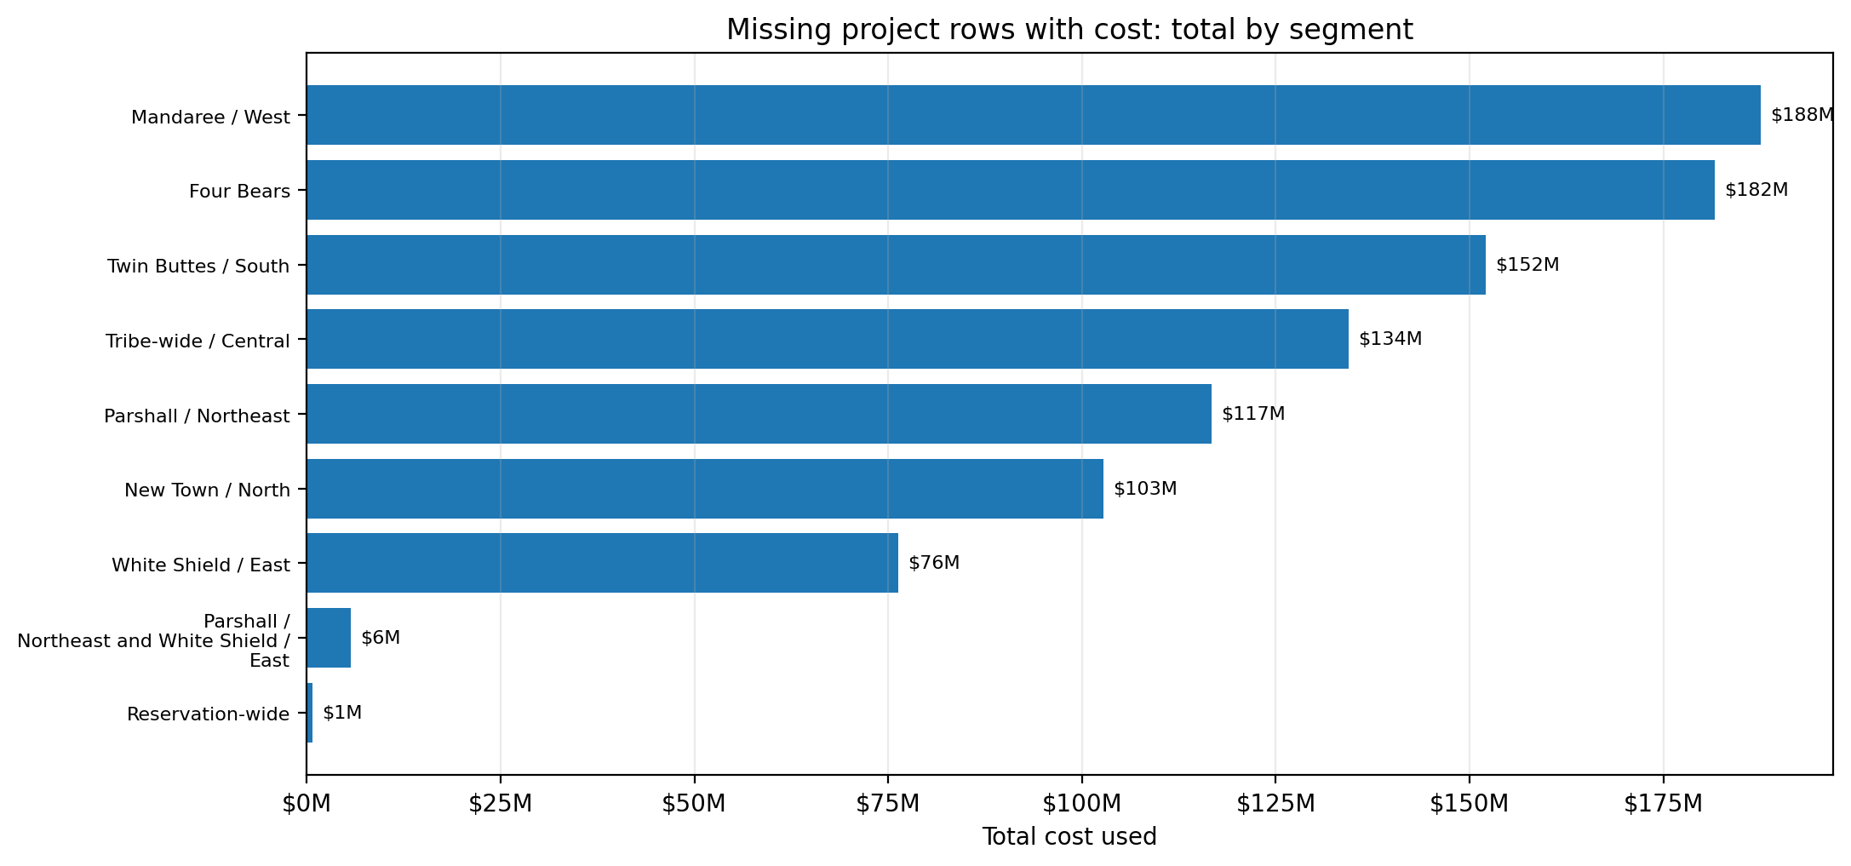
Where the missing-cost project rows are concentrated
Total cost used by segment
Source: mha_project_list_missing_from_first_spreadsheet(1).xlsx
5

Slide 6
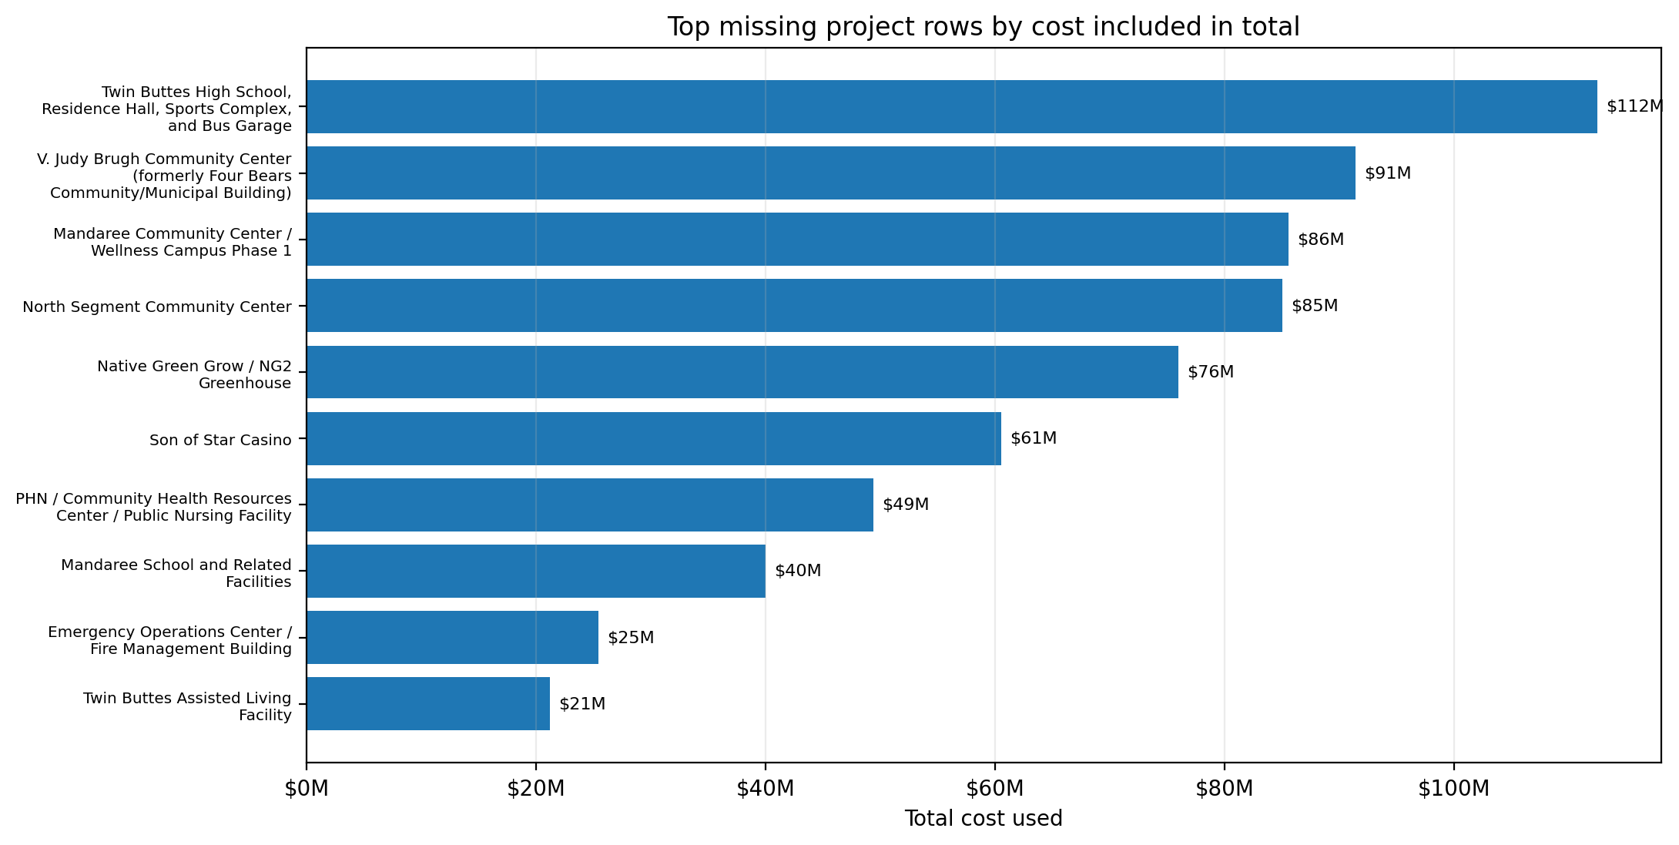
Largest missing project rows by cost
Top items marked as cost included in grand total
Source: mha_project_list_missing_from_first_spreadsheet(1).xlsx
6

Slide 7
Top project details for reconciliation
Examples from the flagged rows with the largest cost values
Project
Segment
Year
Cost used
Twin Buttes High School, Residence Hall, Sp…
Twin Buttes / South
2023
$112.5M
V. Judy Brugh Community Center (formerly Fo…
Four Bears
2021
$91.4M
Mandaree Community Center / Wellness Campus…
Mandaree / West
2023
$85.6M
North Segment Community Center
New Town / North
2023
$85.0M
Native Green Grow / NG2 Greenhouse
Parshall / Northeast
2025
$76.0M
Son of Star Casino
White Shield / East
2023
$60.5M
PHN / Community Health Resources Center / P…
Tribe-wide / Central
2022
$49.4M
Mandaree School and Related Facilities
Mandaree / West
2018
$40.0M
Use the project rows to pull the full authorization trail: original resolution, later amendments, EAs, change orders, and budget actions.
Do not treat the “cost used” figure as audited expenditure; treat it as the number to verify against source documents.
Source: mha_project_list_missing_from_first_spreadsheet(1).xlsx
7

Slide 8
What is missing?
Most flagged rows are missing resolution/action numbers
84
2
Missing resolution/action number rows
Minutes/action reference rows without resolution number
Why this matters
A resolution or action number is the crosswalk between a project list, minutes, contracts, budget authority, and payments.
When an ID is missing from the first spreadsheet, the project may not be fully represented in the initial project/expenditure analysis.
Rows with only a minutes/action reference should be traced to the original meeting packet and any later ratification.
Source: mha_project_list_missing_from_first_spreadsheet(1).xlsx
8

Slide 9
Reconciliation plan
Turn the flagged spreadsheet into a source-document review
1
Confirm identity
Normalize each resolution/action number and confirm whether it is truly absent from the first spreadsheet.
2
Pull source files
Obtain minutes, resolutions, EAs, contracts, amendments, budget modifications, and change orders.
3
Tie to money
Match each project to its budget line, funding source, payment records, and any later modifications.
4
Separate categories
Separate original project costs from change orders, amendments, grants, loans, and reimbursements.
5
Report exceptions
Create an exceptions list showing missing amounts, conflicting amounts, missing signatures, and unsupported totals.
The spreadsheet is a roadmap for reconciliation: it identifies where to look first.
Source: mha_project_list_missing_from_first_spreadsheet(1).xlsx
9

Slide 10
Questions to answer next
Use the missing project rows to build a defensible exhibit record
DOCUMENTATION QUESTIONS
FINANCIAL QUESTIONS
Which resolution/action approved each project or amendment?
Was a dollar amount stated, capped, or left unstated?
Was the project approved before work began or ratified later?
Was the funding source identified and lawful?
Was the amount included in the annual budget or a later amendment?
Were change orders and amendments tracked separately?
Were payments made from restricted or unrestricted funds?
Does the trial balance match the authorization trail?
$957.8M in project costs are tied to the included missing rows — enough to justify a focused source-document review.
Source: mha_project_list_missing_from_first_spreadsheet(1).xlsx
10

Slide 11
Bottom line
The comparison shows an important project documentation gap
The first spreadsheet does not appear to capture all resolution/action IDs in the MHA Project List.
128 MHA resolution/action IDs were not found in the first spreadsheet.
84 project rows were flagged in the comparison summary.
$957.8M in costs were associated with the included project rows that need reconciliation.
The next step is not to assume wrongdoing; it is to obtain the source documents and reconcile every flagged project against budget authority and payment records.
Question for review: Which projects, costs, and approvals were missing from the original analysis — and why?
Source: mha_project_list_missing_from_first_spreadsheet(1).xlsx
11

Slide 12
Next step
Build the source-document packet for each flagged project row.
Prioritize the largest-cost projects first, then reconcile each missing resolution/action number to the minutes, resolution, contract, budget amendment, and payment record.
Deliverable: a defensible exceptions list that can be reviewed by leadership, auditors, counsel, and the public.
12

